Slide 1
Scalable Multi-Period Optimal Power Flow for Active Power Distribution Systems or simply, Scalable MP-OPF in ADS
Latest Updates: tADMM convergence for Copper Plate MPOPF - Results
tADMM formulation - What was changed
Battery action plots improved for clarity
Convergence plots improved for clarity
Aryan Ritwajeet Jha
Pursuing PhD ECE (Power Systems)
Washington State University
Notes:
Remember to hit the reset button to make sure all the page elements react properly.
There are 20 different layouts that you can choose from.

Slide 2
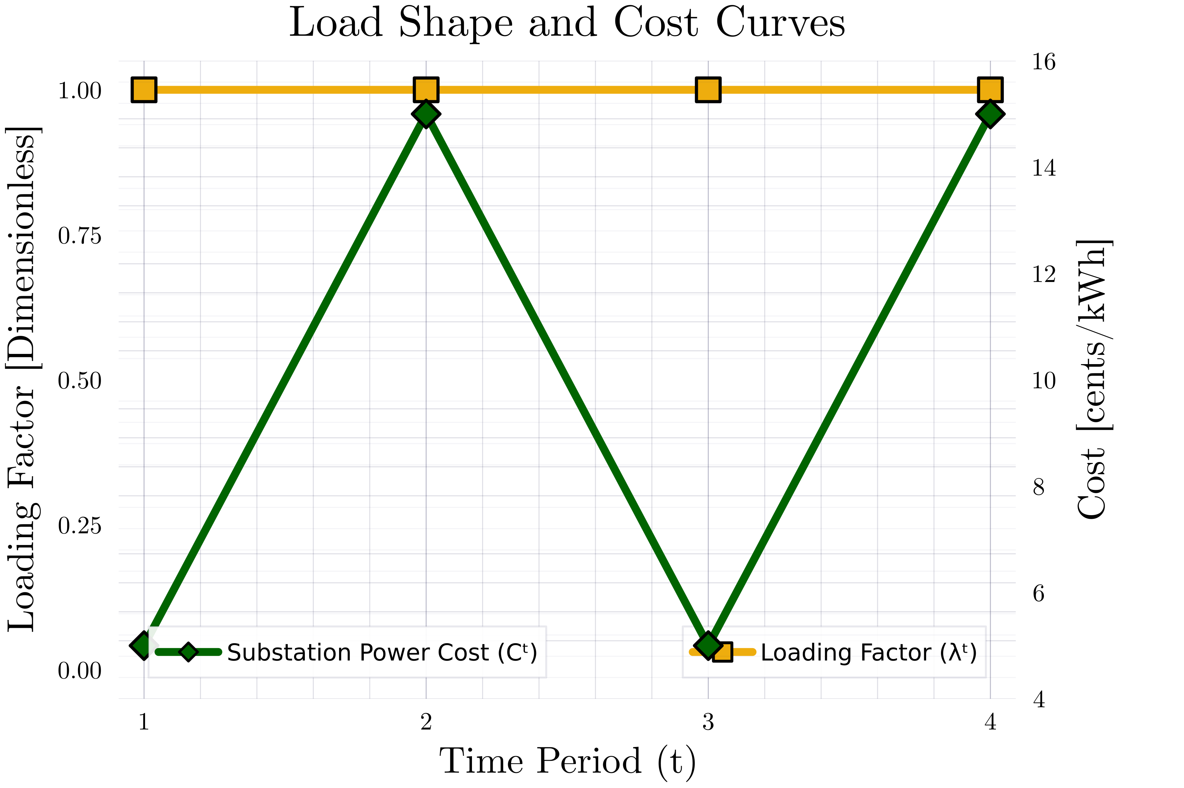
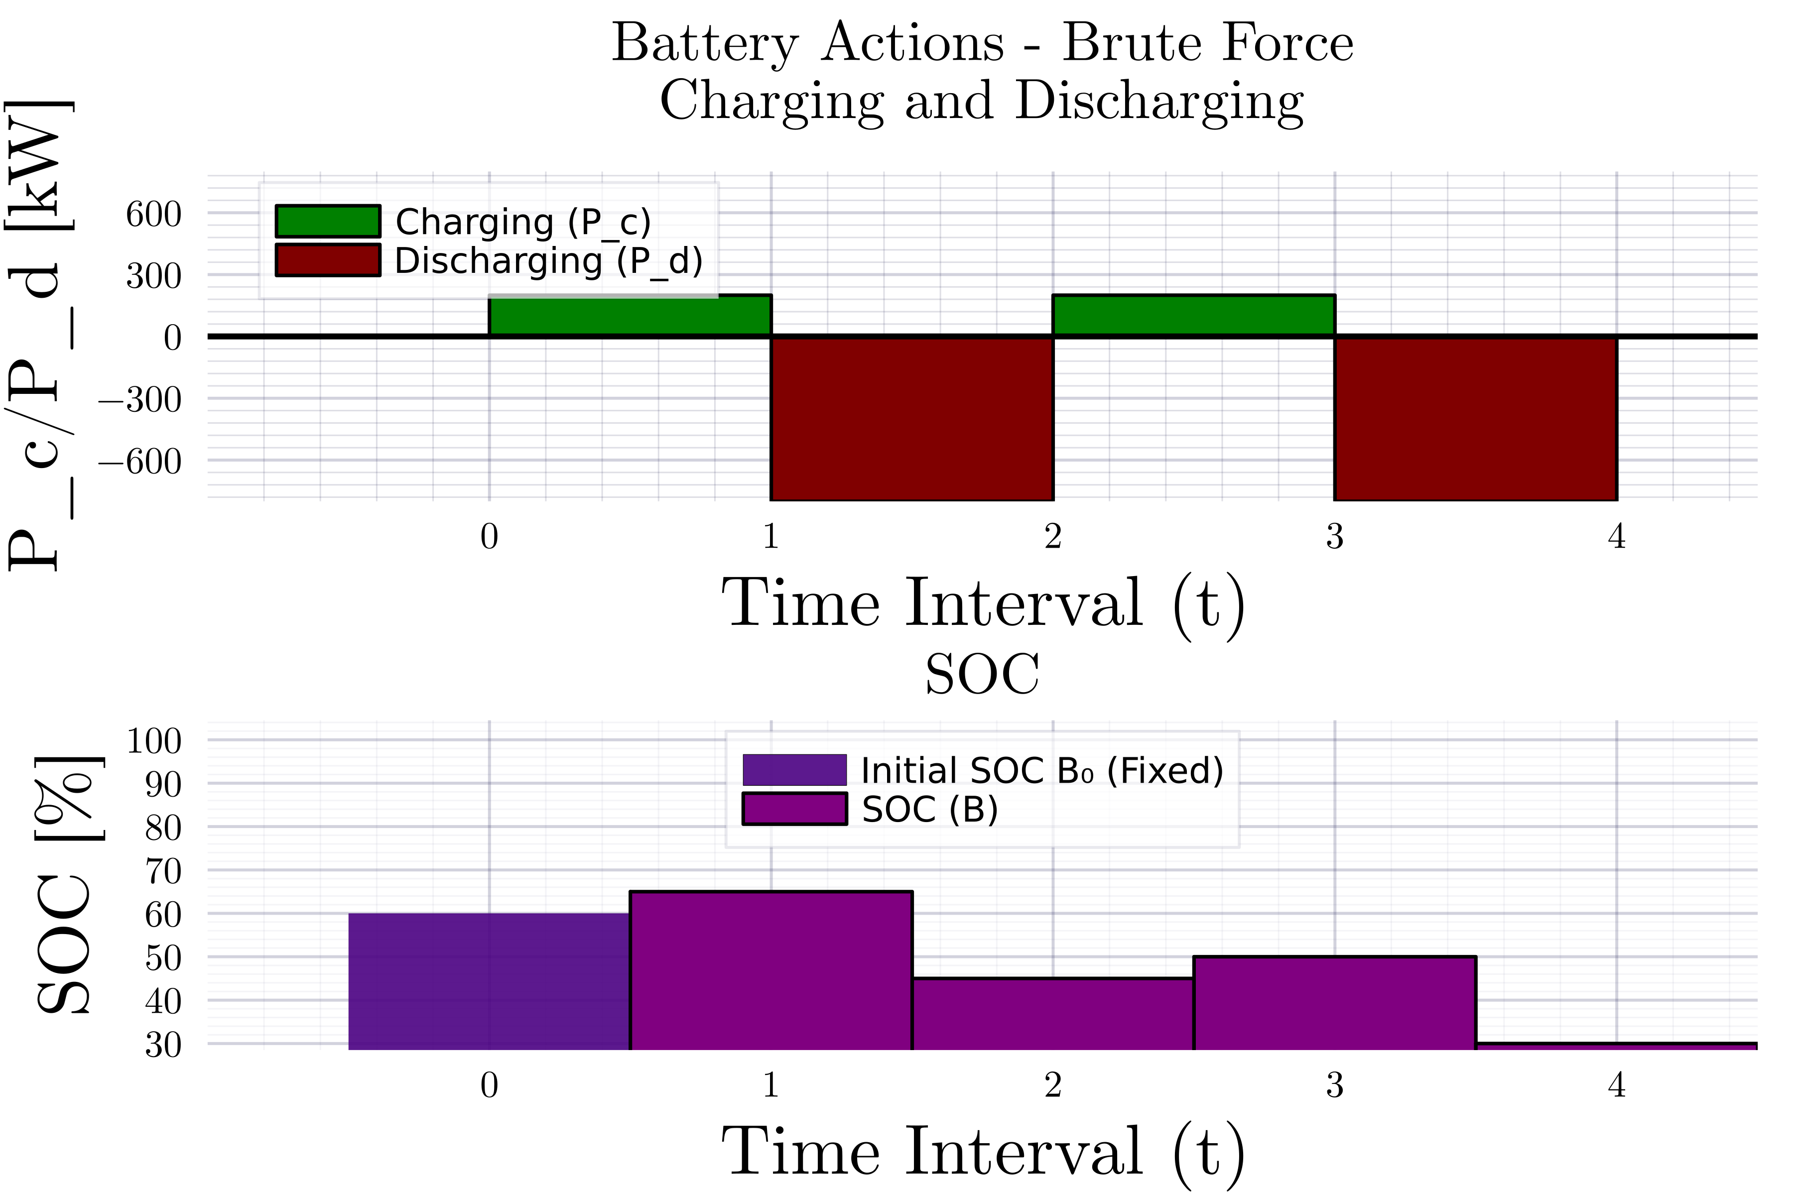

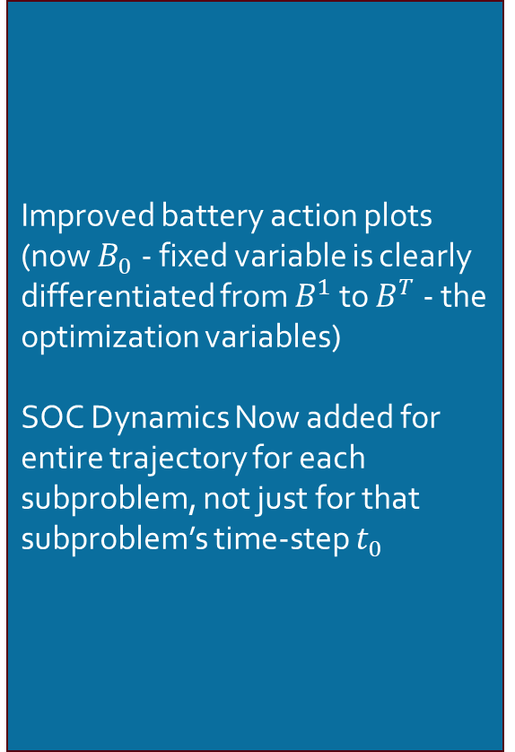
Consensus ADMM for MPOPF $T=4$
Description
Improved battery action plots (now $B_{0}$ - fixed variable is clearly differentiated from $B^{1}$ to $B^{T}$ - the optimization variables)
SOC Dynamics Now added for entire trajectory for each subproblem, not just for that subproblem’s time-step $t_{0}$
Implementational correction [Courtesy: Rahul] It was found that my subproblem primal updates were overwriting each other instead of being compiled as part of a set. Fixed.

Slide 3
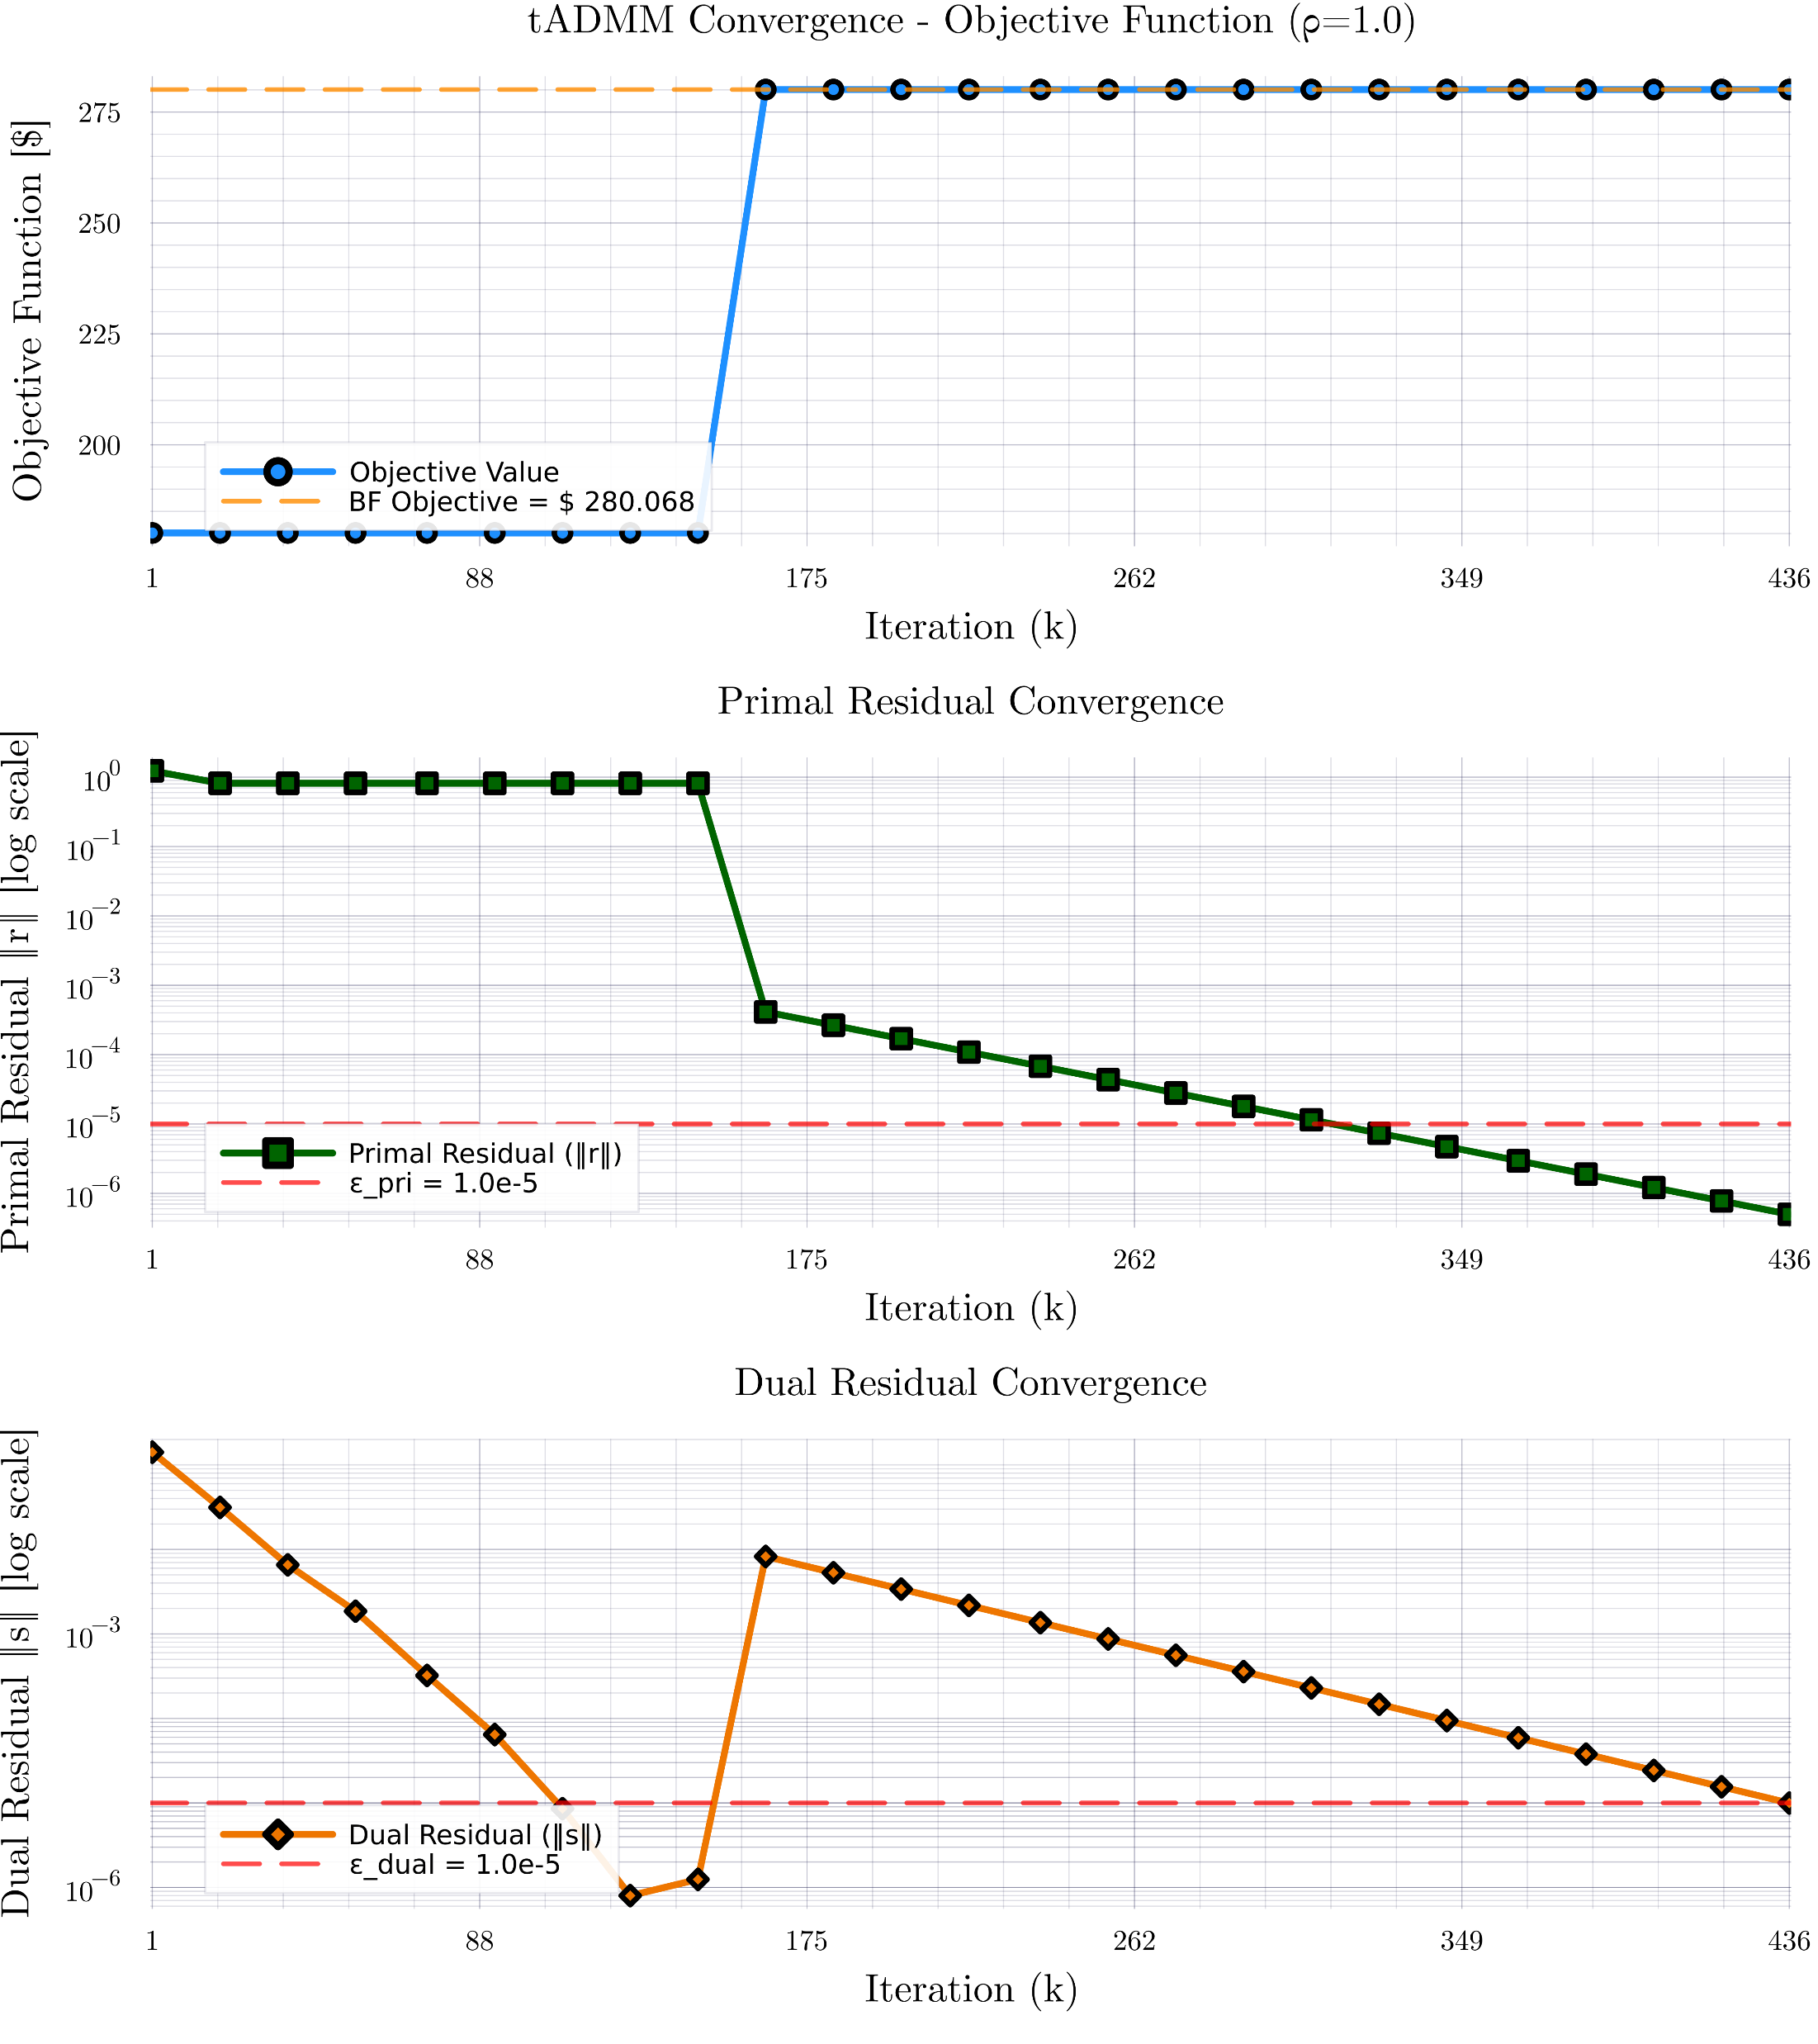
Consensus ADMM for MPOPF $T=4$

Slide 4
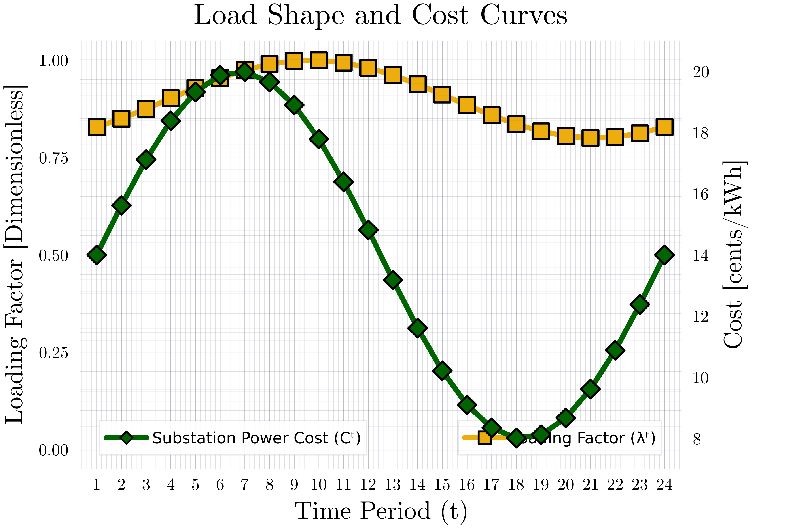
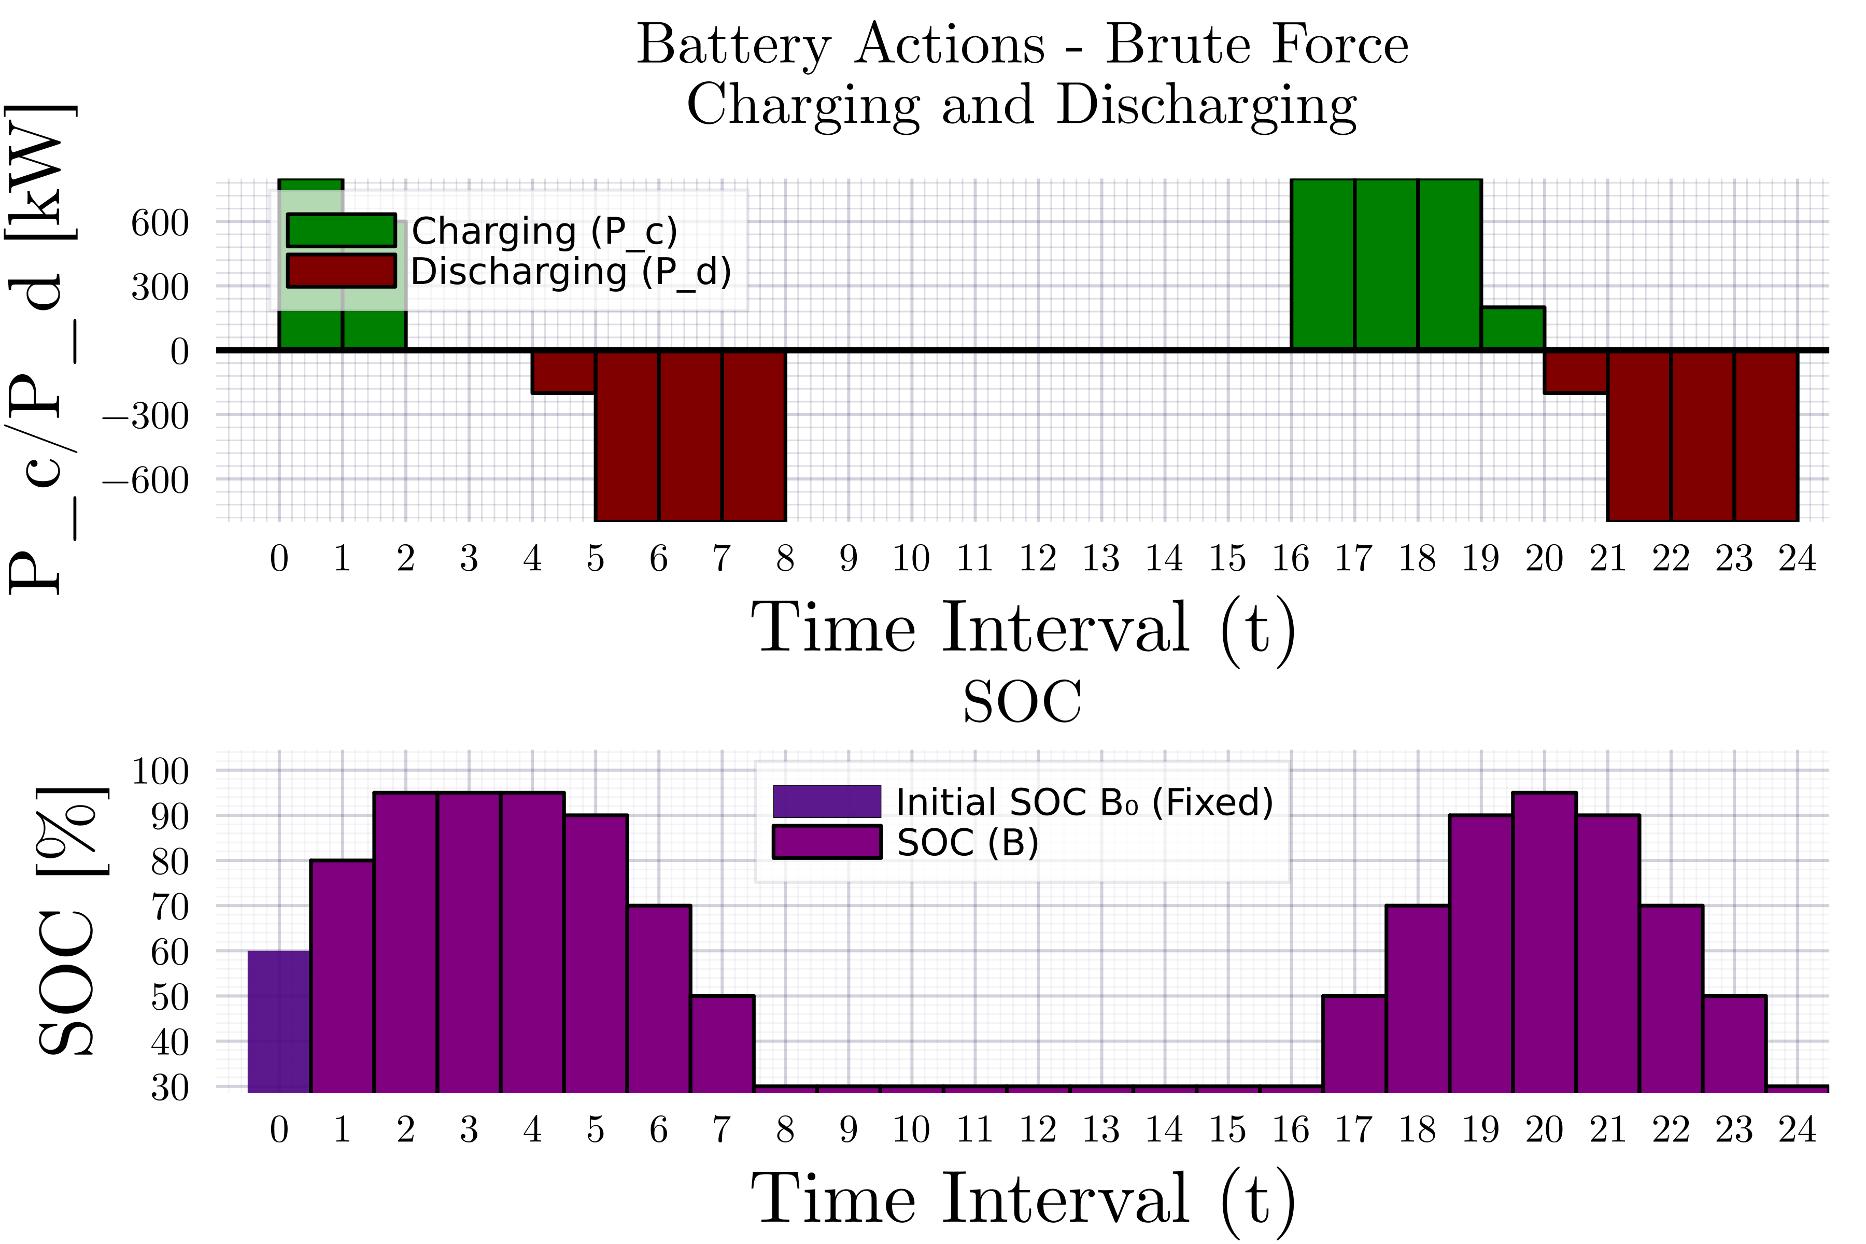

Consensus ADMM for MPOPF $T=24$

Slide 5
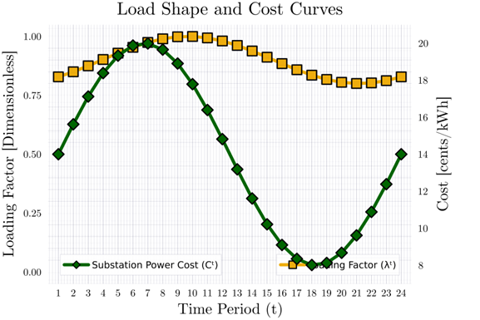
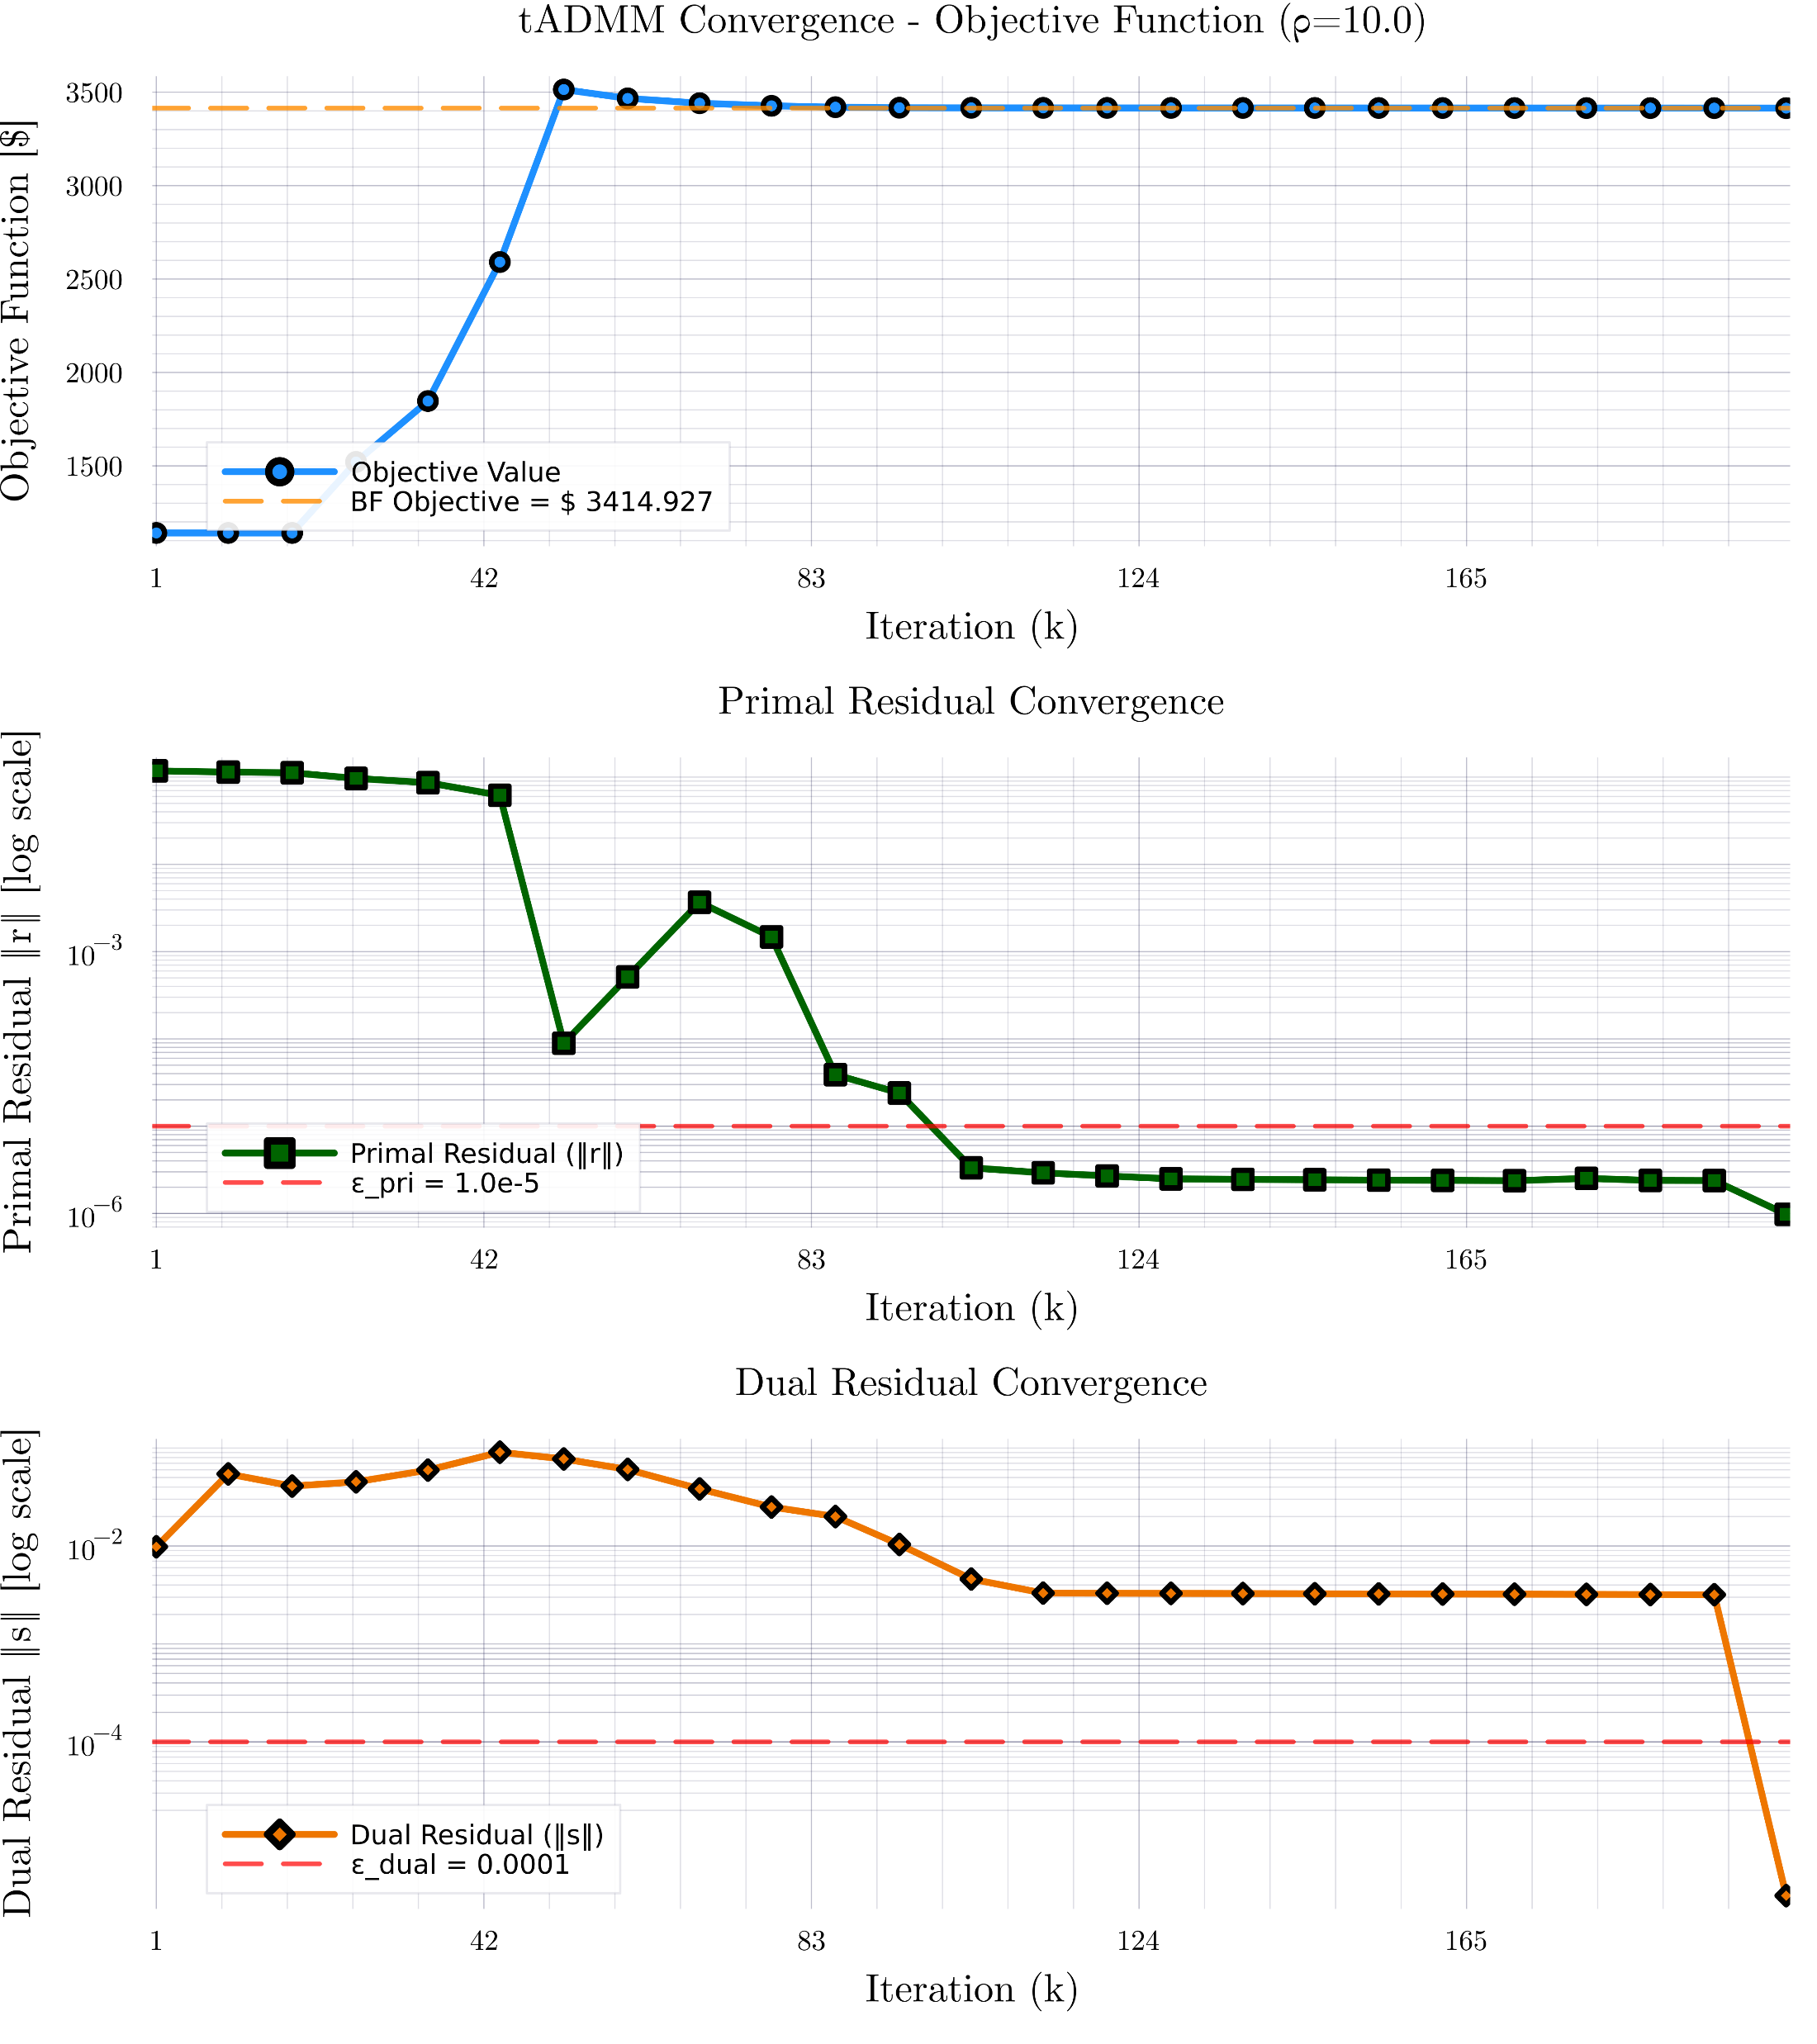
Consensus ADMM for MPOPF $T=24$

Slide 6
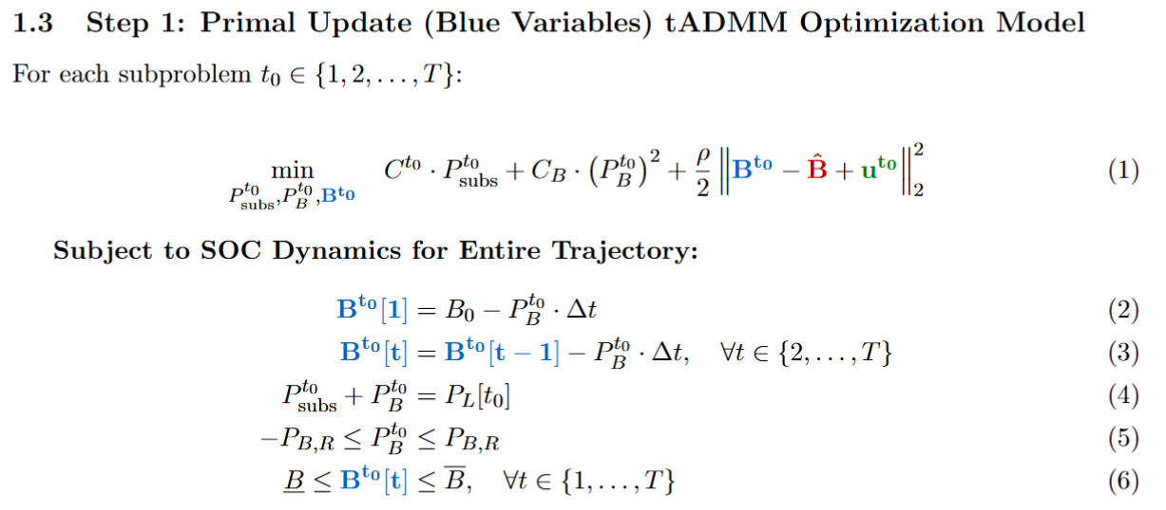
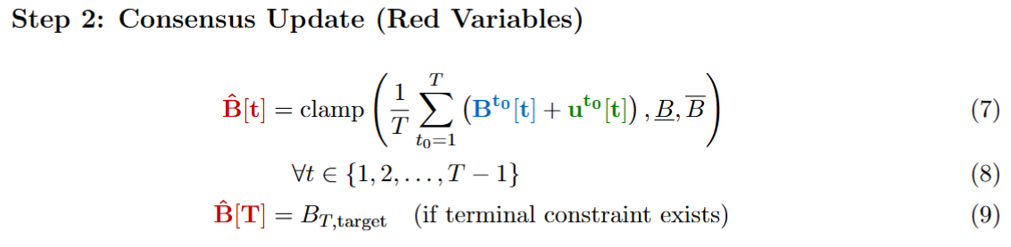
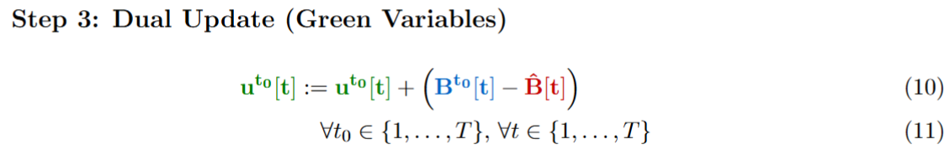
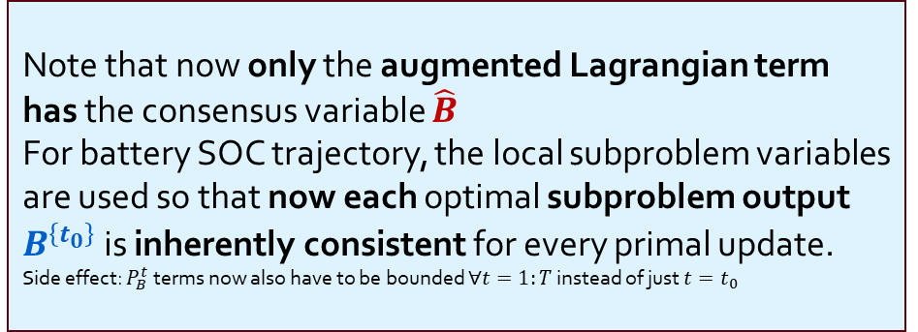
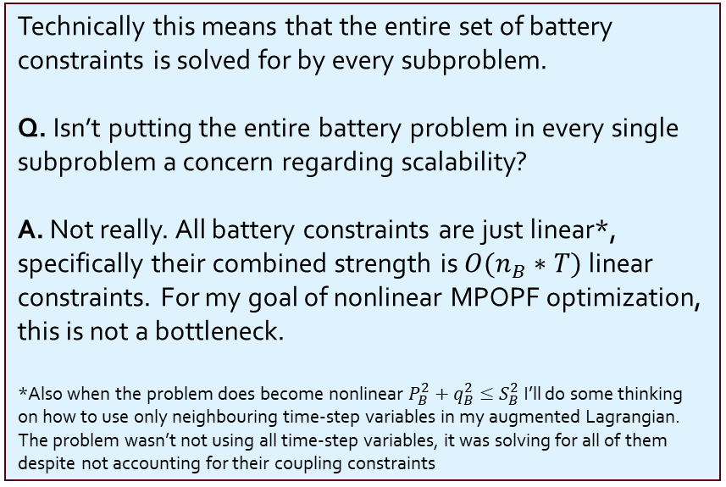
ADMM Optimization Formulation for Copper Plate ($1$ Substation, $1$ Load, $1$ Battery, $T$ timesteps of cost $C^{t},$loading $λ^{t}$)
Note that now only the augmented Lagrangian term has the consensus variable $\hat{B}$
For battery SOC trajectory, the local subproblem variables are used so that now each optimal subproblem output $B^{\left\{t_{0}\right\}}$ is inherently consistent for every primal update.
Side effect: $P_{B}^{t}$ terms now also have to be bounded $∀t=1:T$ instead of just $t=t_{0}$
Technically this means that the entire set of battery constraints is solved for by every subproblem.
Q. Isn’t putting the entire battery problem in every single subproblem a concern regarding scalability? A. Not really. All battery constraints are just linear*, specifically their combined strength is ${O(n}_{B}∗T)$ linear constraints. For my goal of nonlinear MPOPF optimization, this is not a bottleneck.
*Also when the problem does become nonlinear $P_{B}^{2}+q_{B}^{2}≤S_{B}^{2}$ I’ll do some thinking on how to use only neighbouring time-step variables in my augmented Lagrangian. The problem wasn’t not using all time-step variables, it was solving for all of them despite not accounting for their coupling constraints

Slide 7

Latest slides end here. Previous slides and/or References may follow.

Slide 8
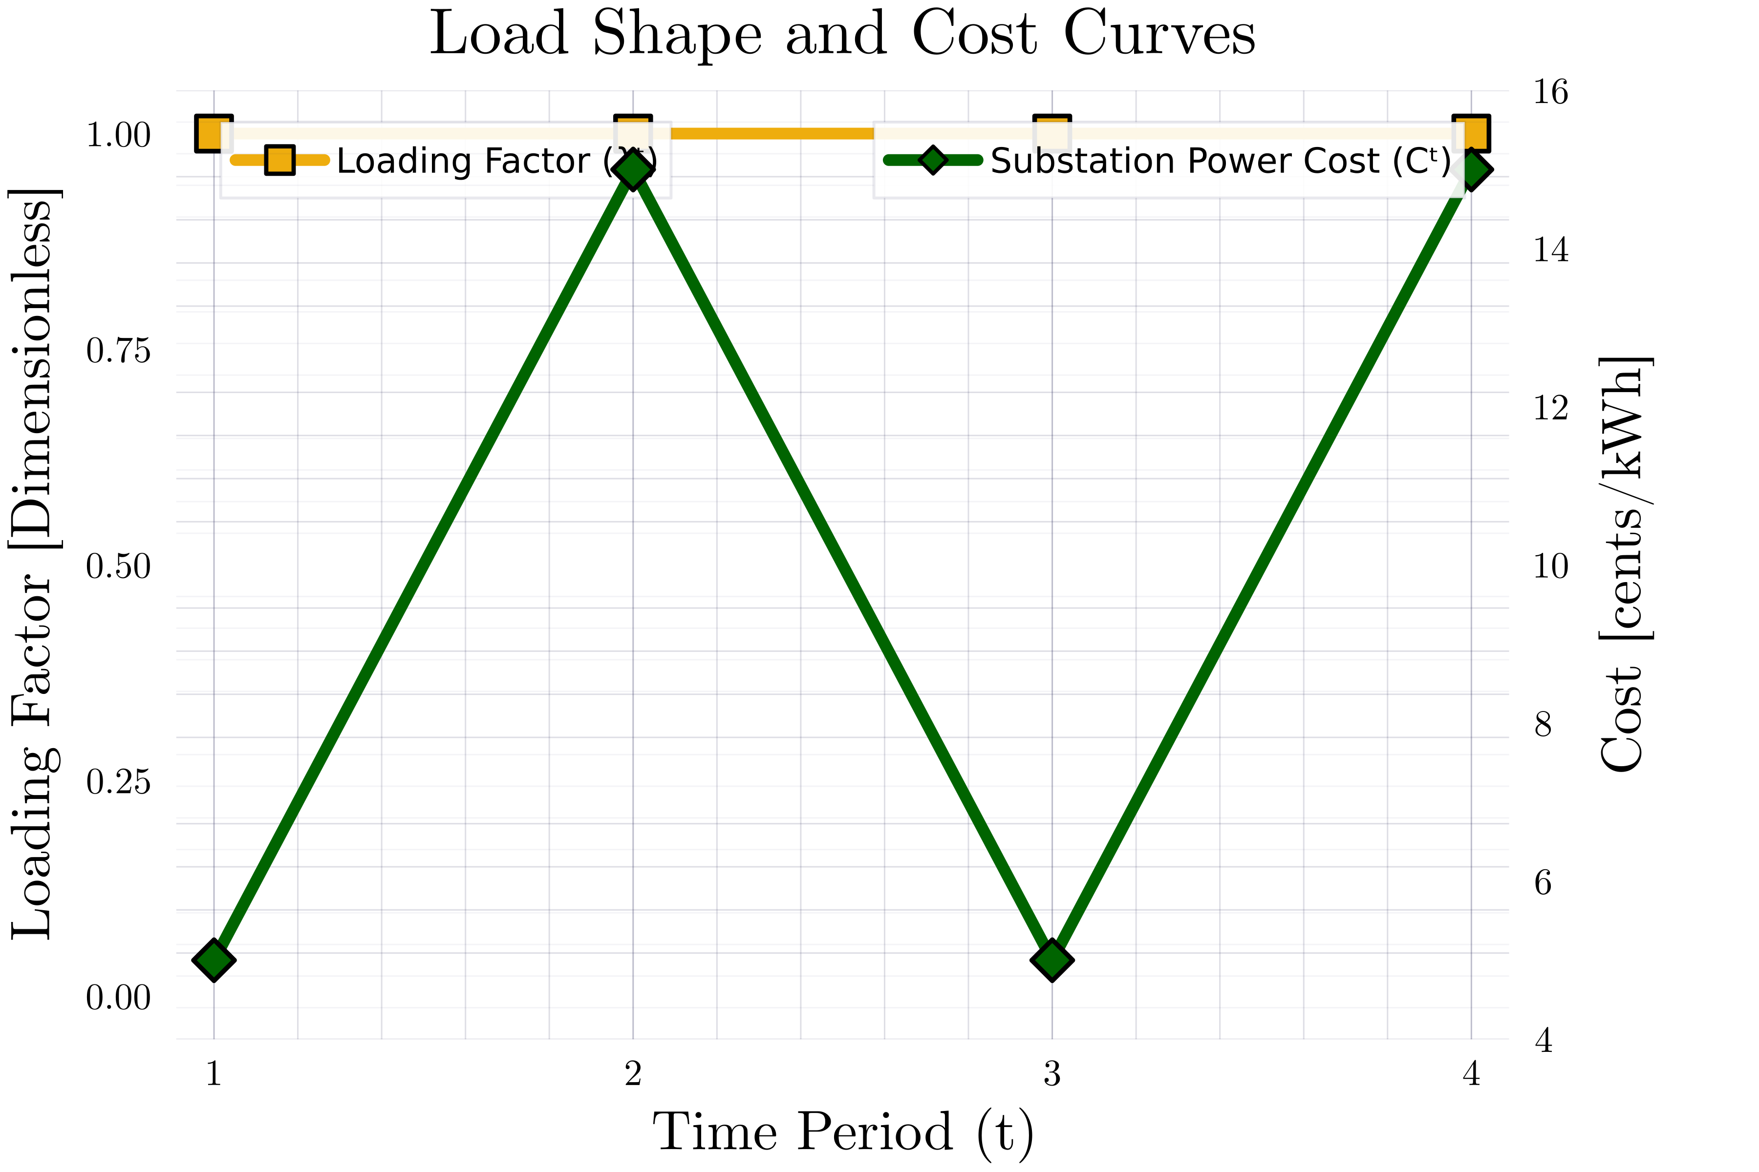
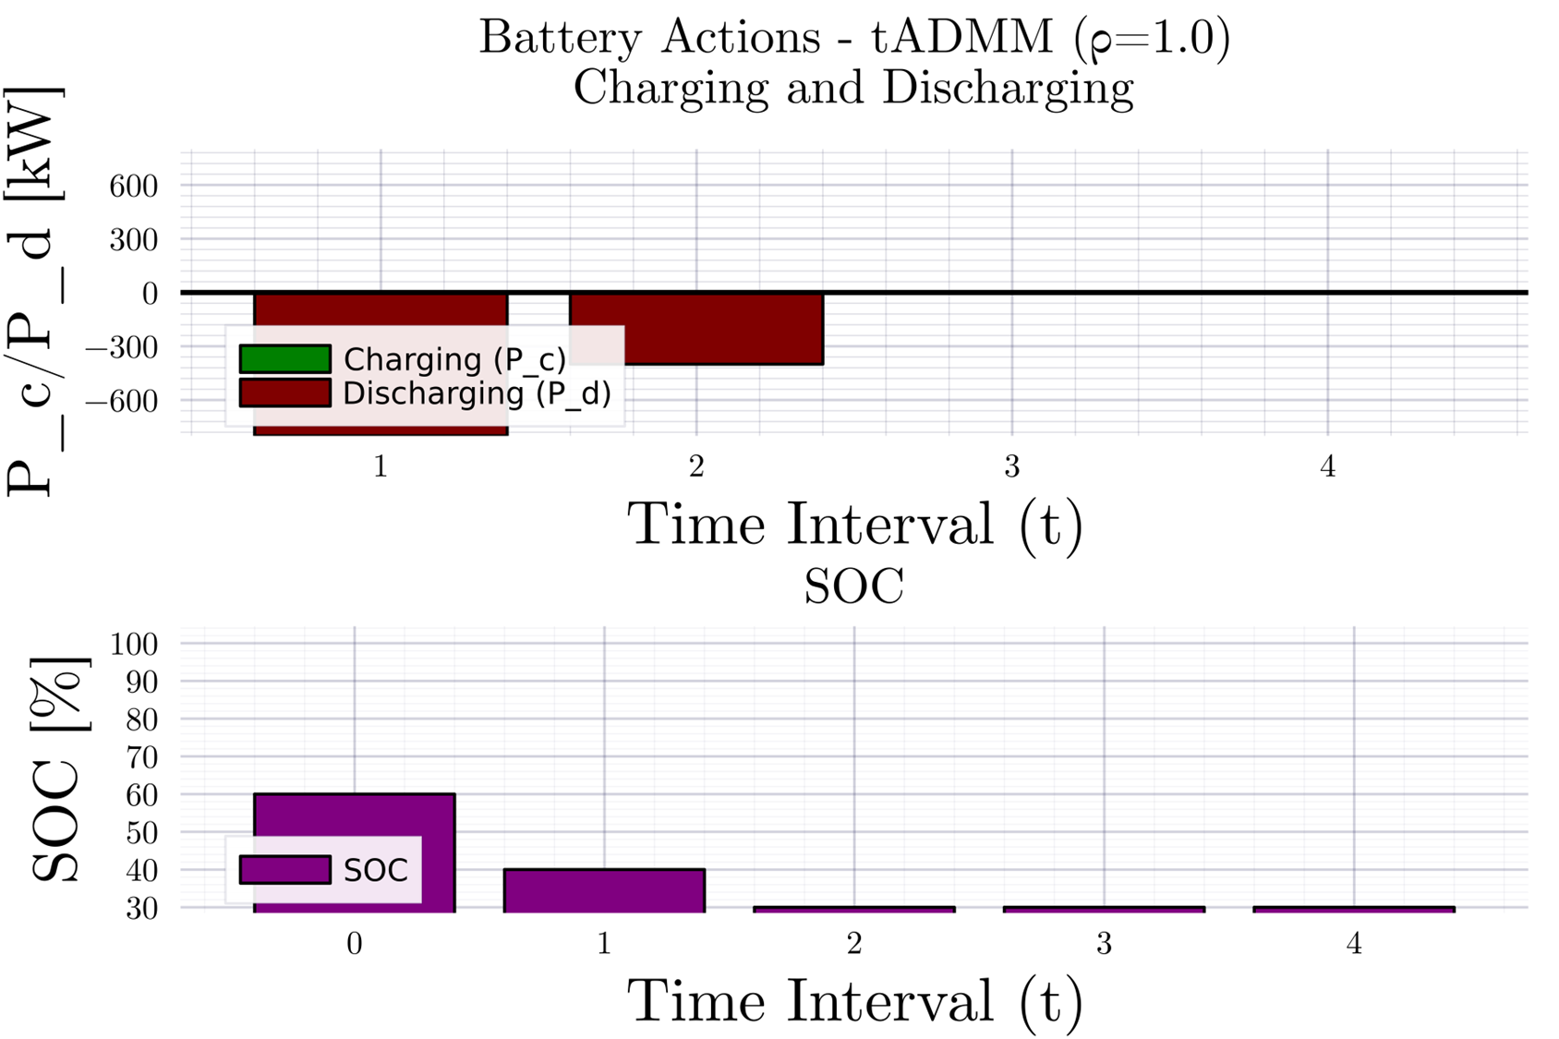
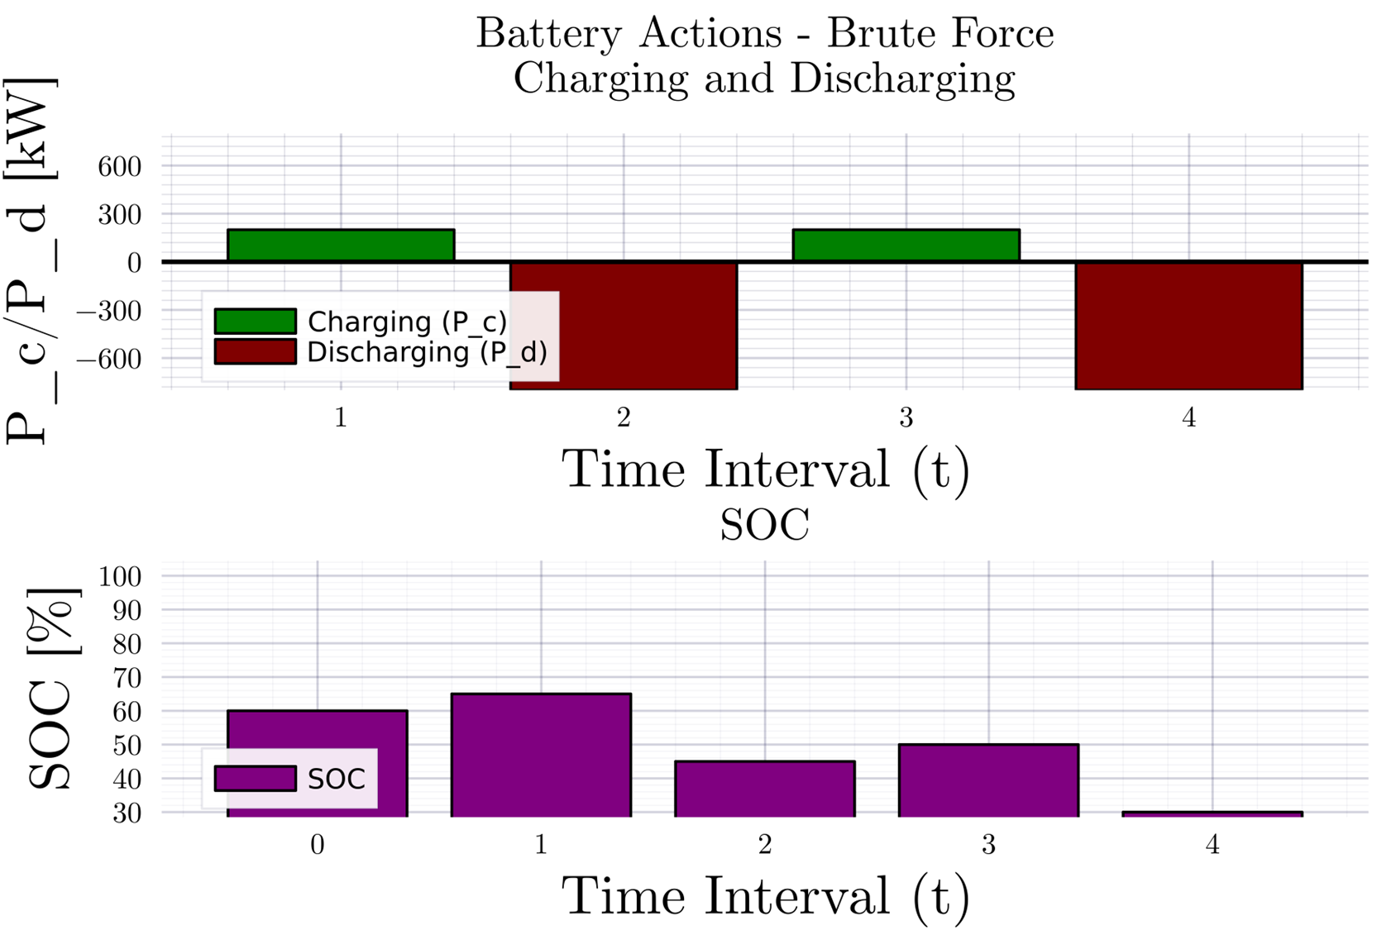
Consensus ADMM formulation for MPOPF $T=4$
Description

Slide 9
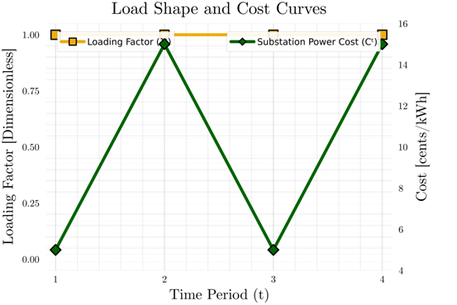
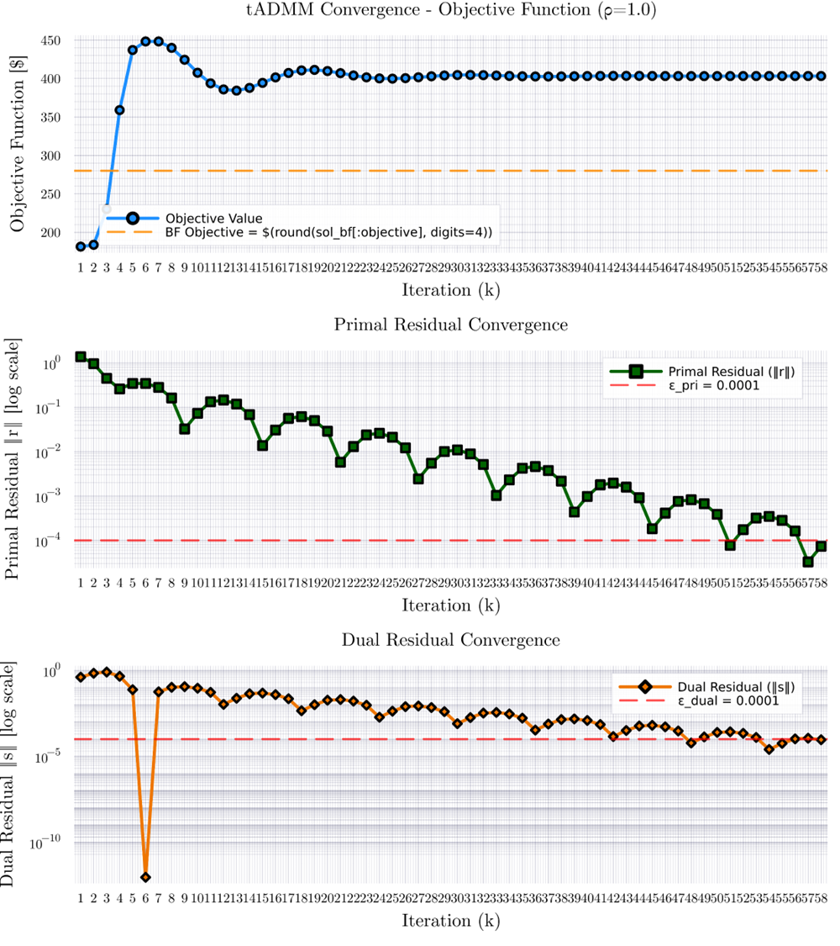
Consensus ADMM formulation for MPOPF $T=4$

Slide 10
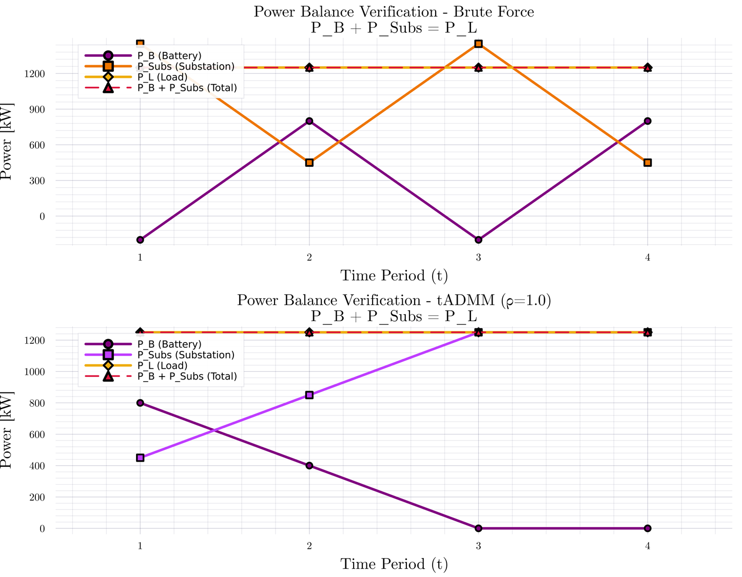
Consensus ADMM formulation for MPOPF $T=4$

Slide 11
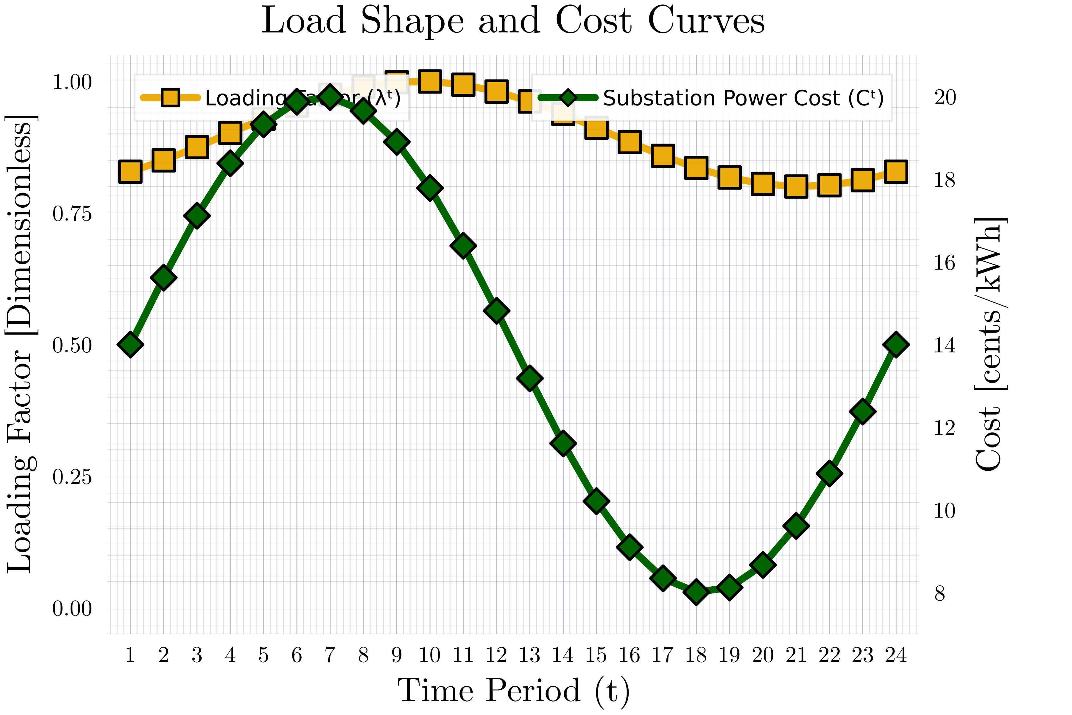
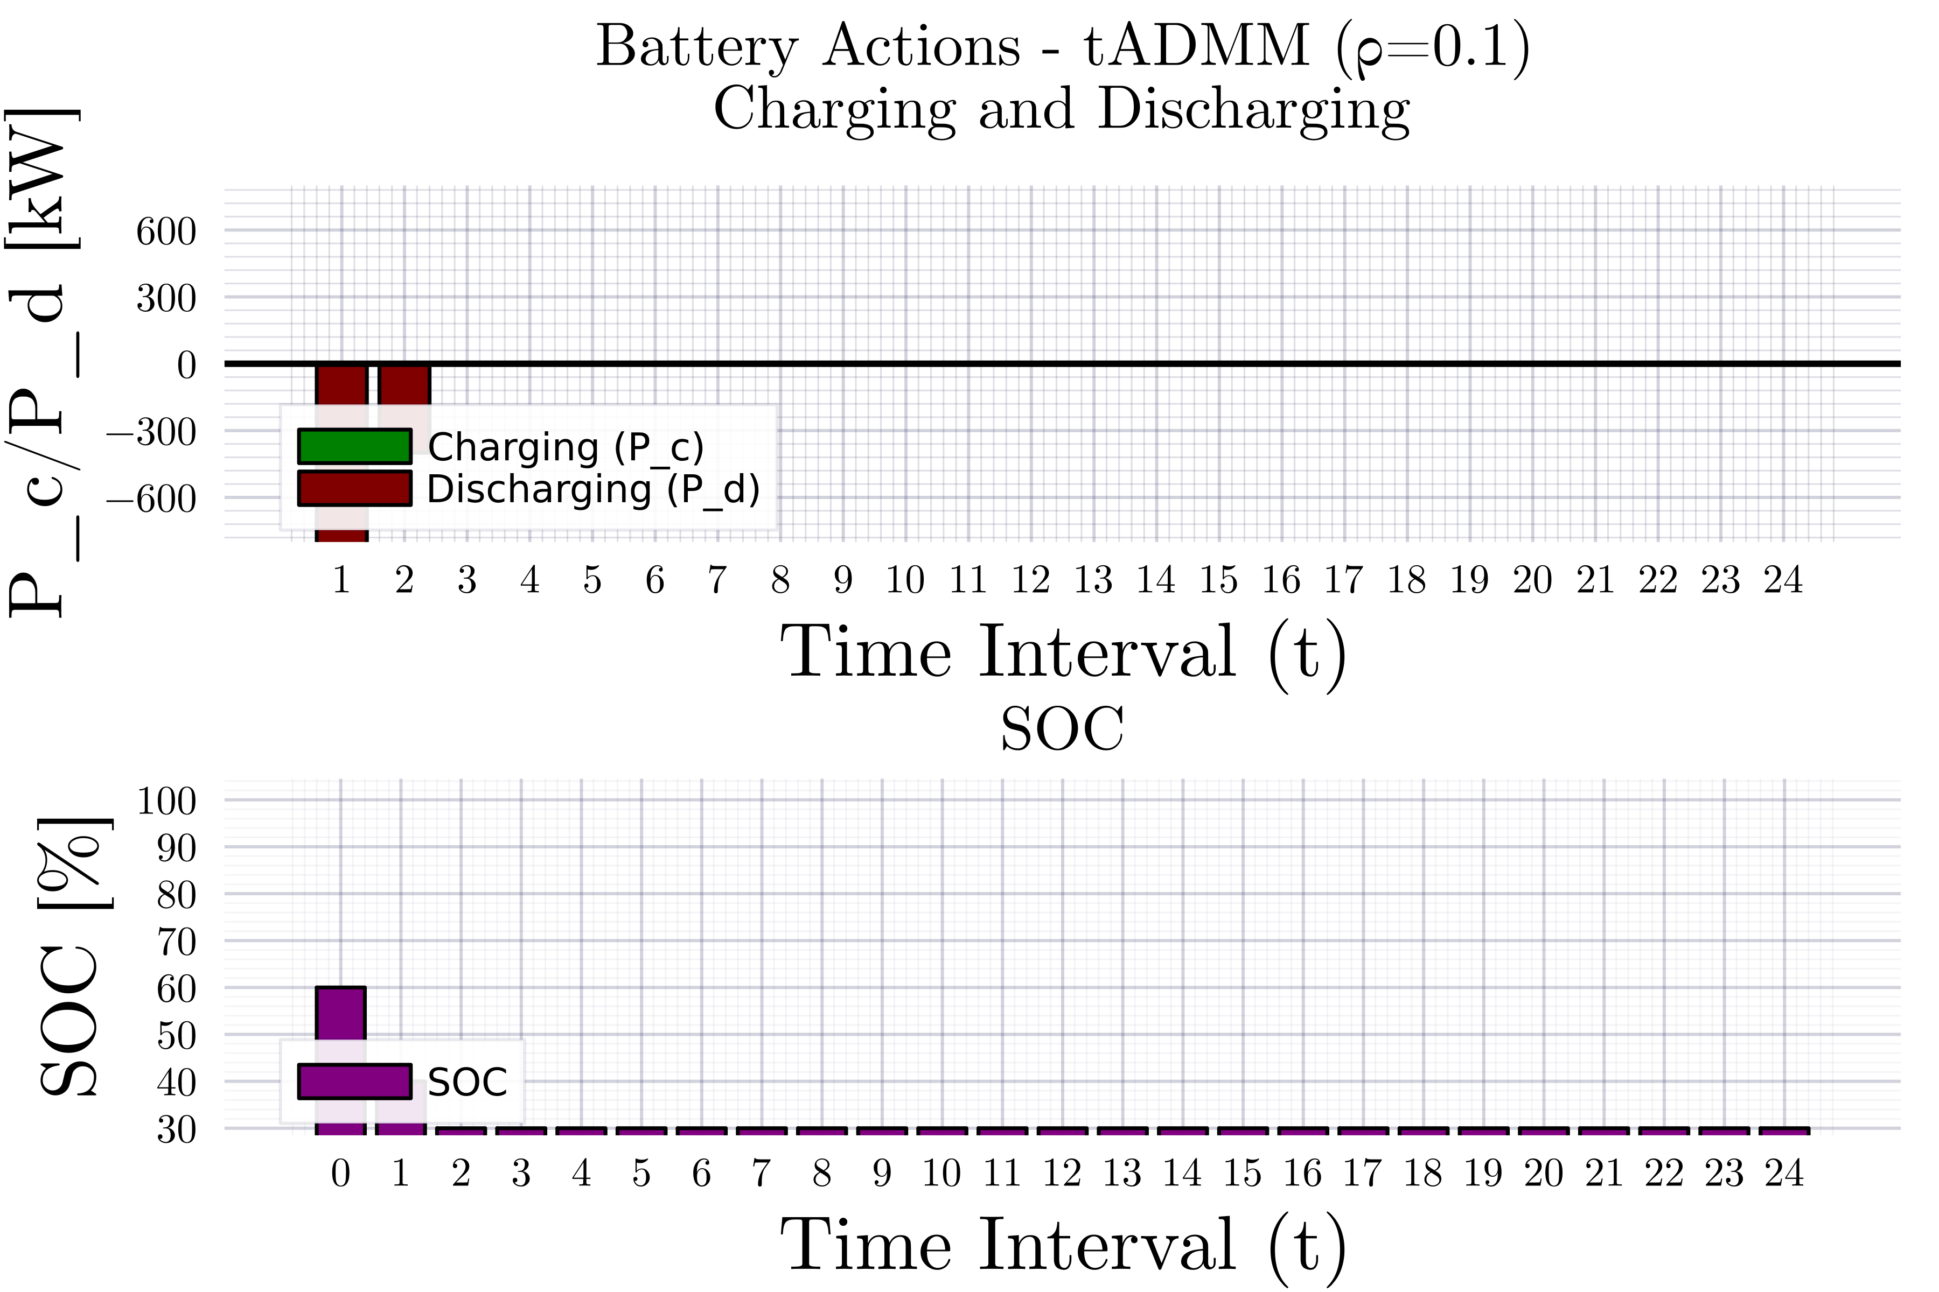
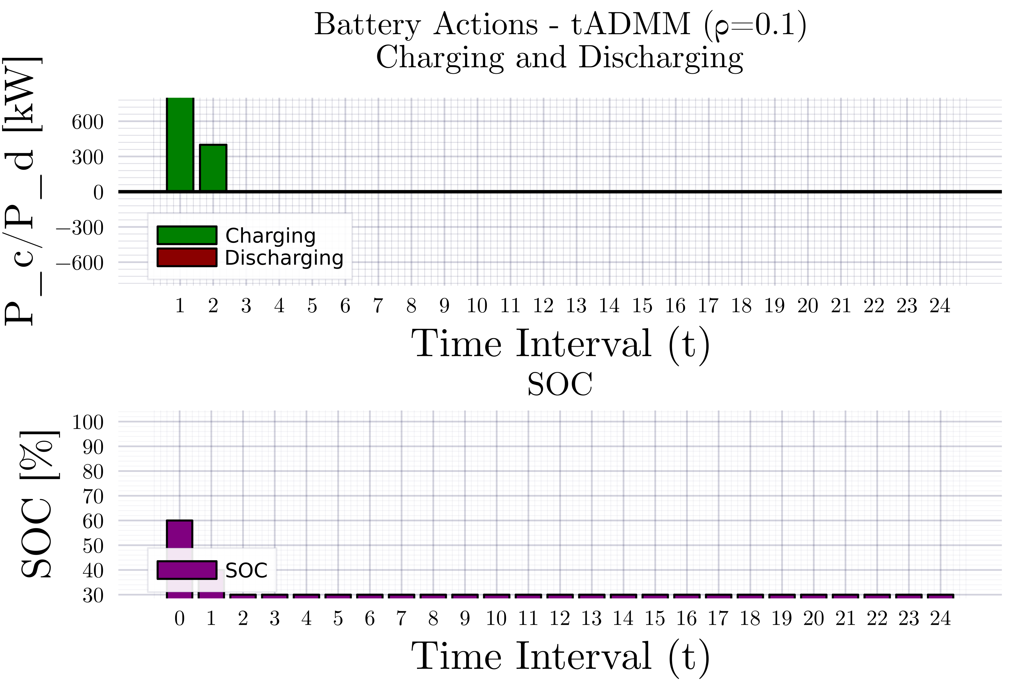
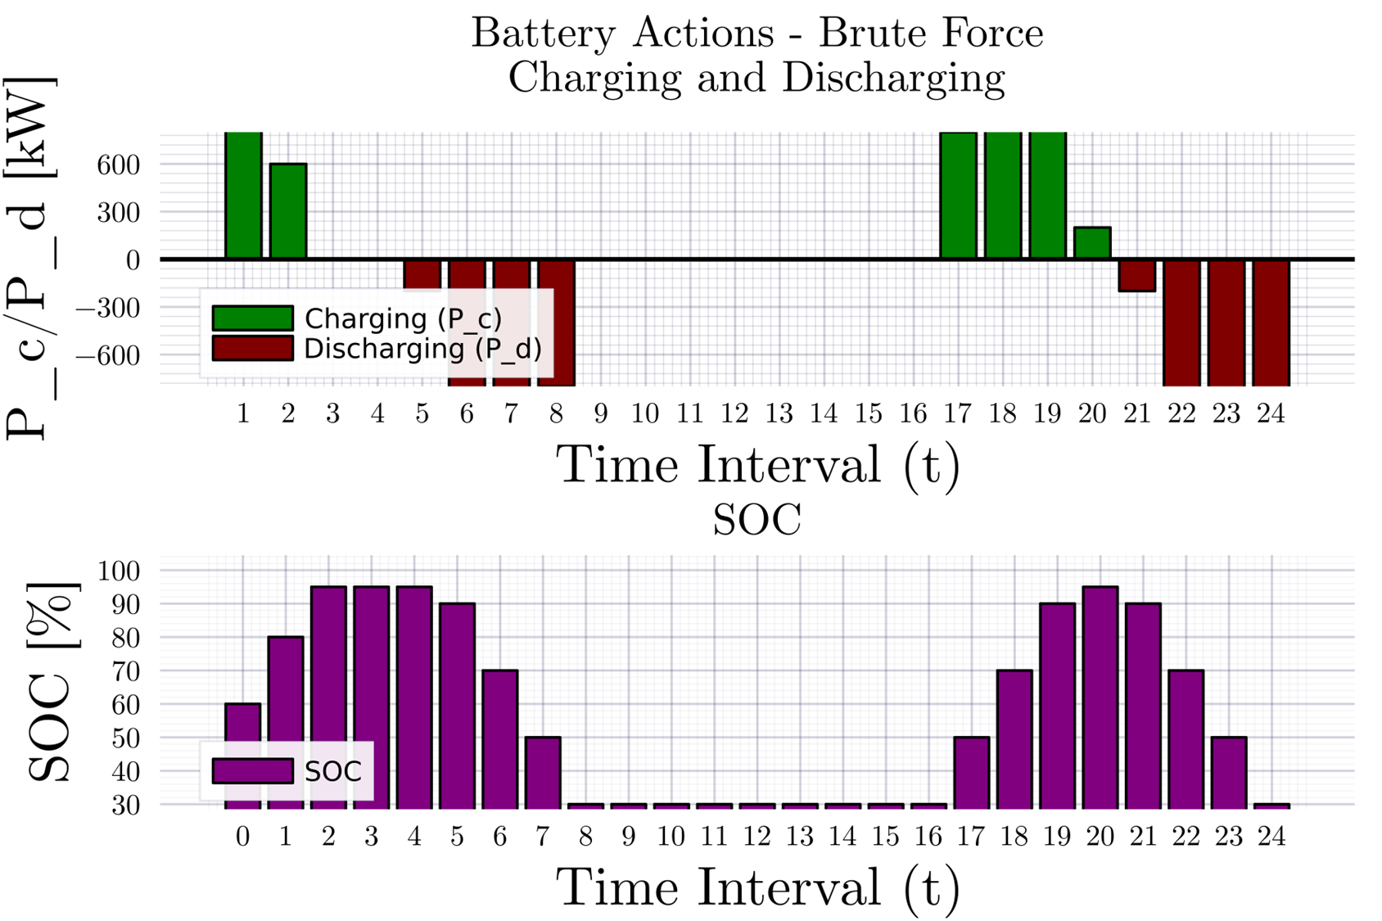
Consensus ADMM formulation for MPOPF
Description

Slide 12
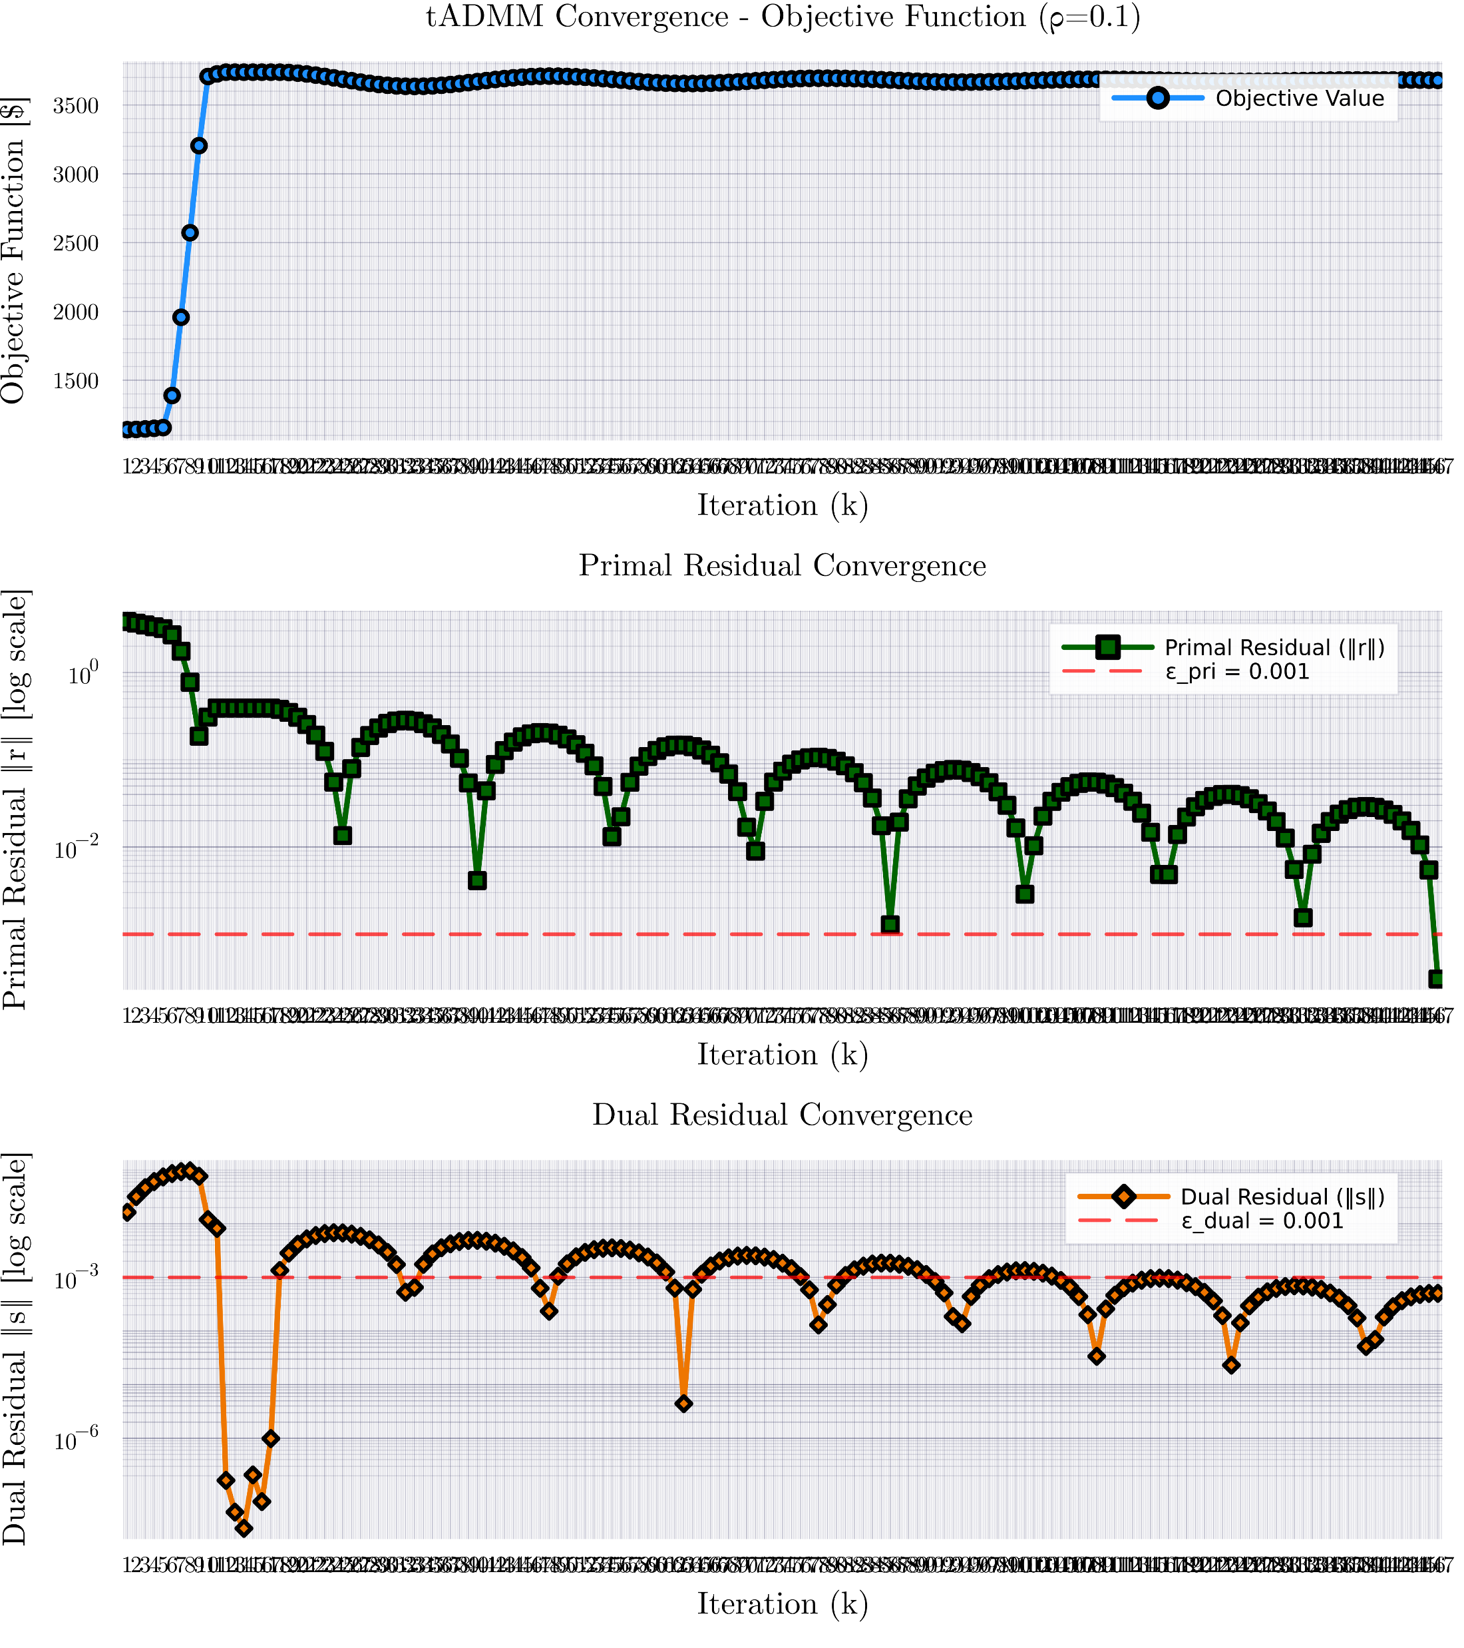
Consensus ADMM formulation for MPOPF

Slide 13
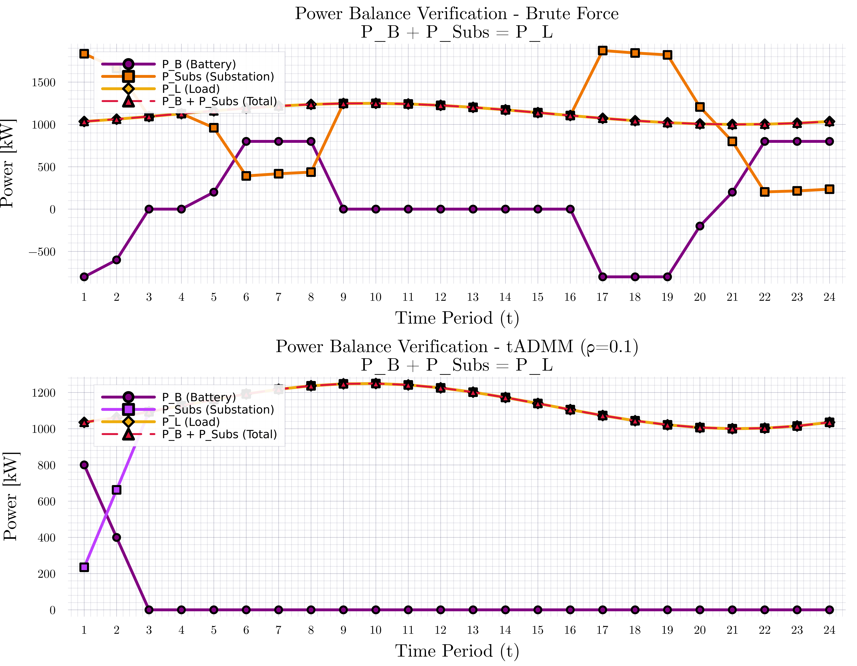
Consensus ADMM formulation for MPOPF

Slide 14
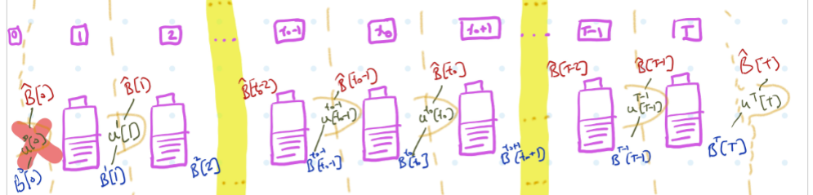
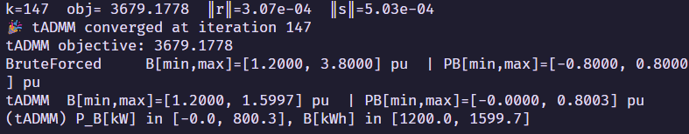
Consensus ADMM formulation for MPOPF
Description

Slide 15
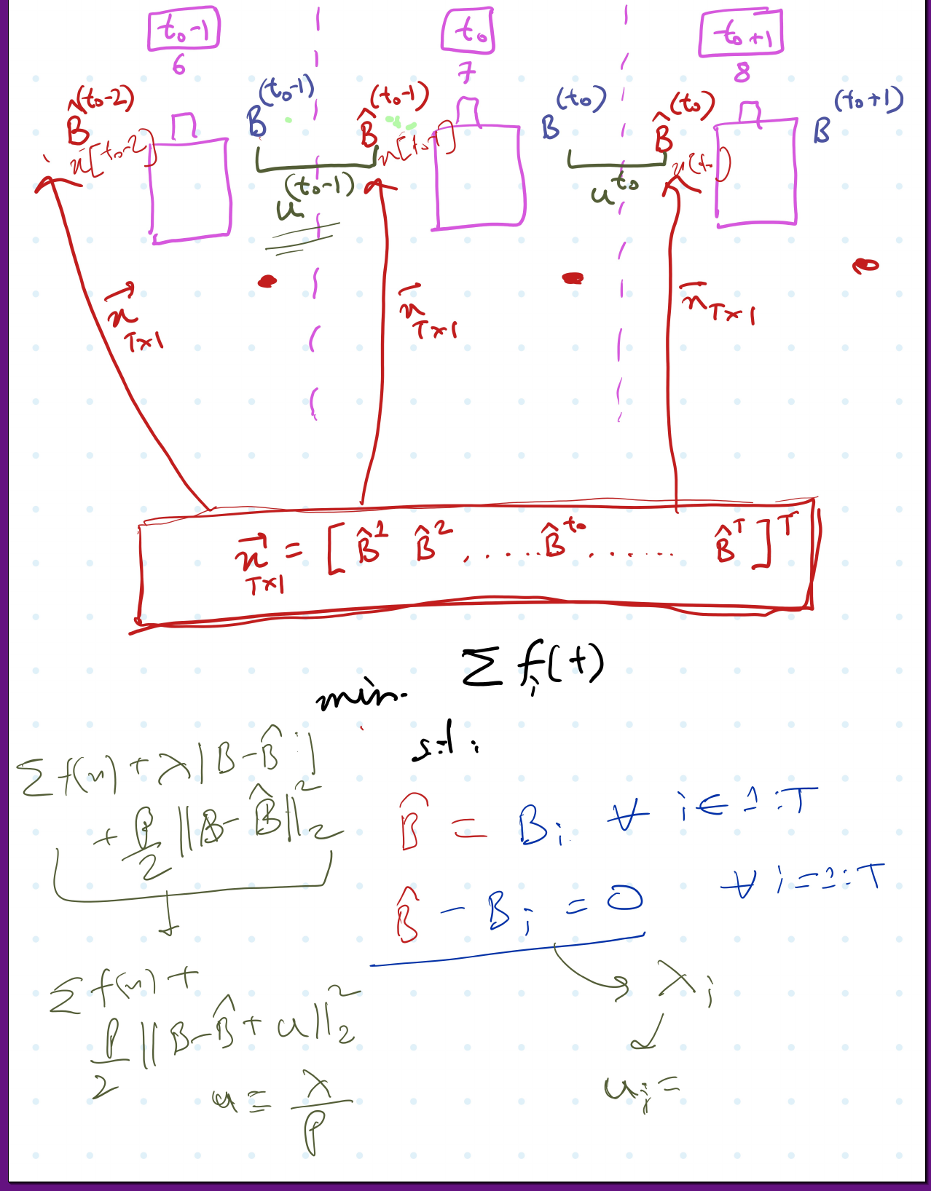
Consensus ADMM formulation for MPOPF
Description

Slide 16
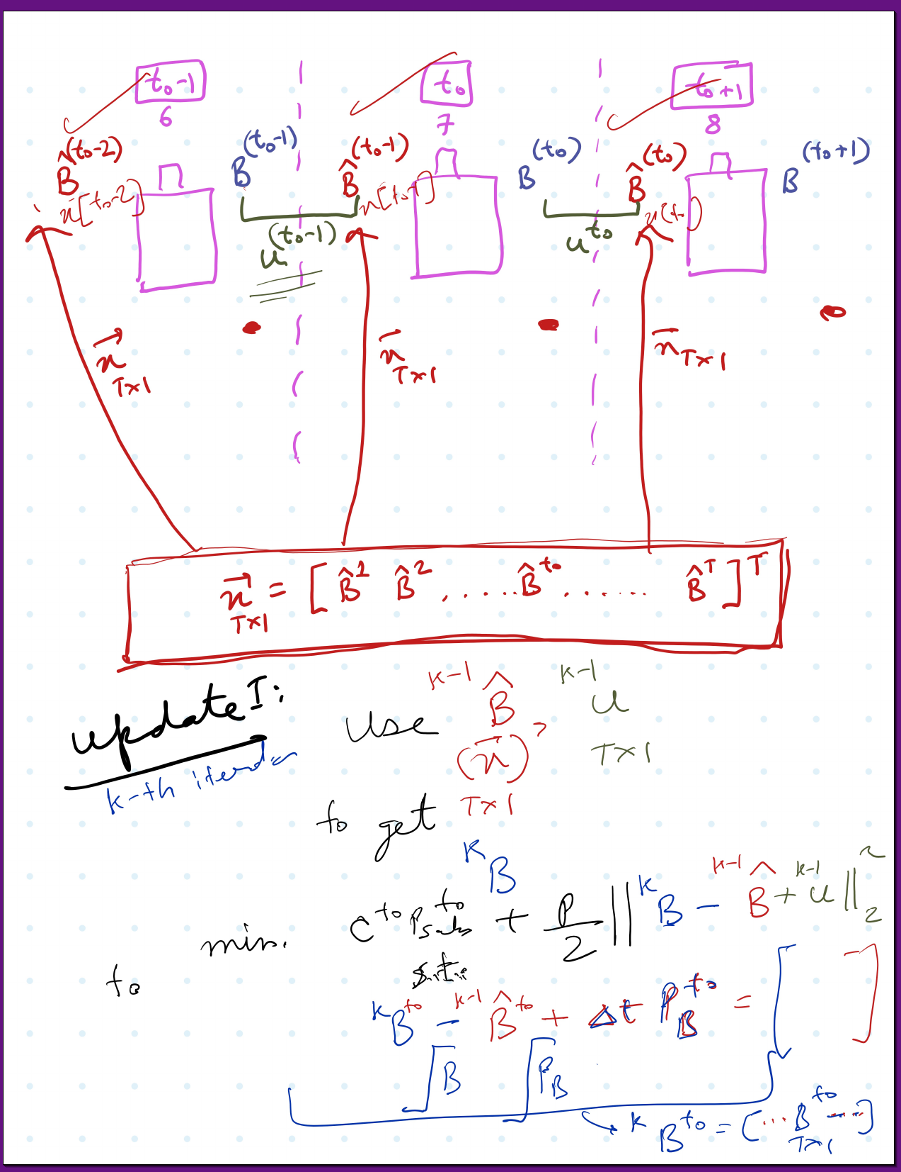
Consensus ADMM formulation for MPOPF
Description

Slide 17
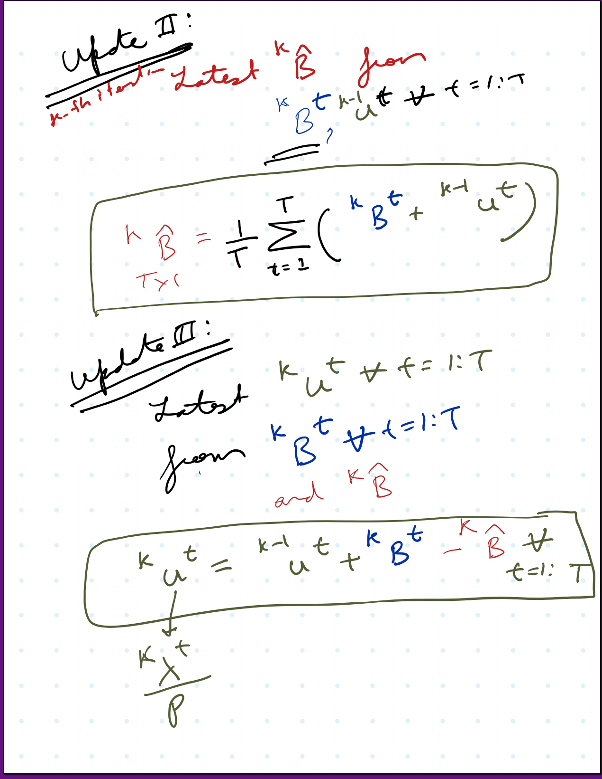
Consensus ADMM formulation for MPOPF
Description

Slide 18
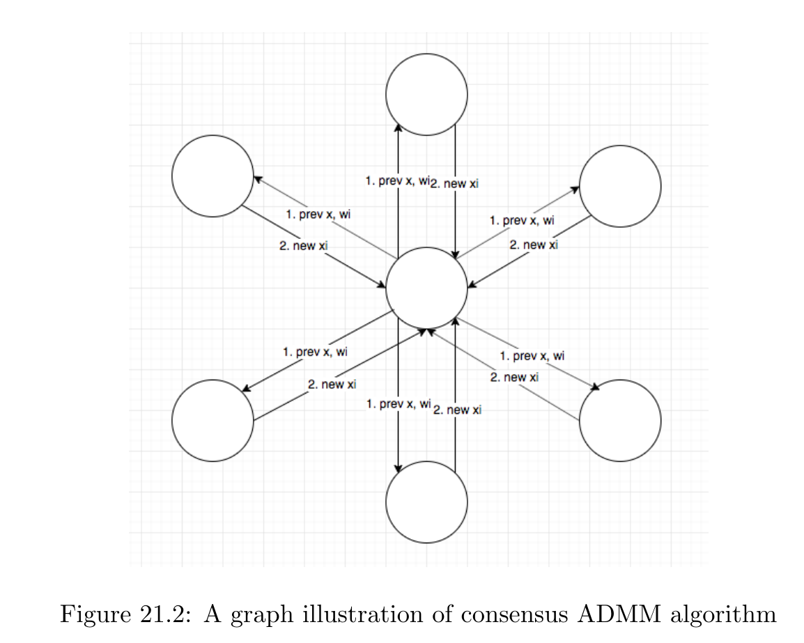
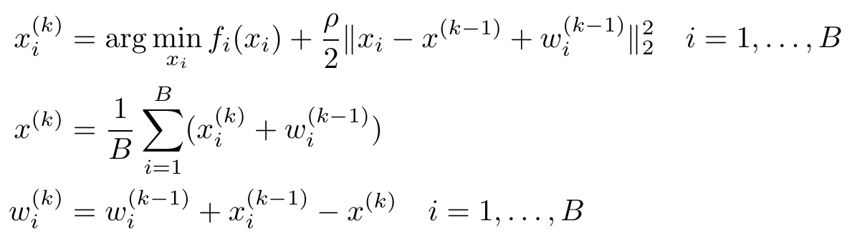
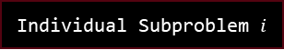
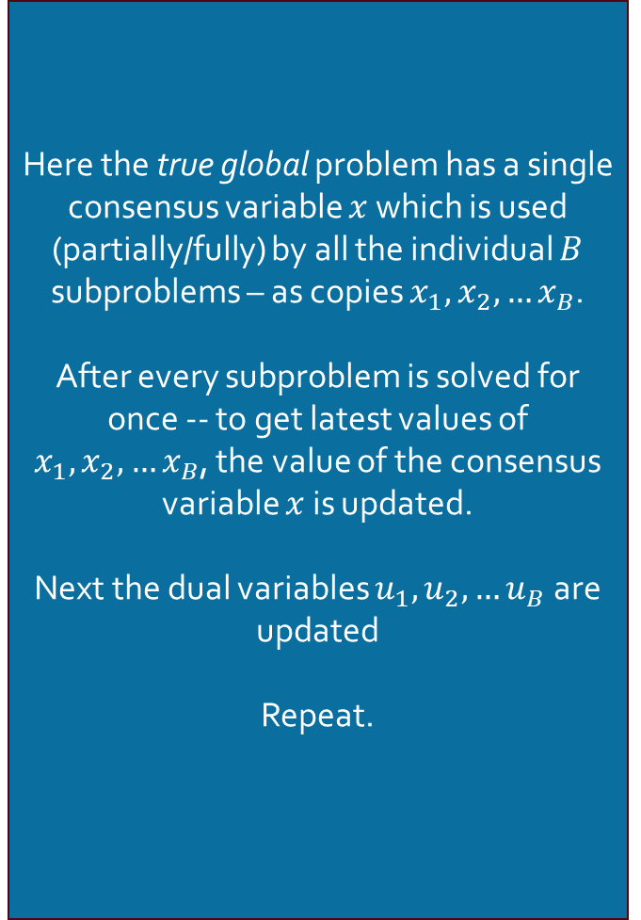
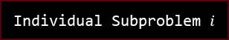
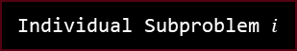

Consensus ADMM formulation
Graph Illustration
Here the true global problem has a single consensus variable $x$ which is used (partially/fully) by all the individual $B$ subproblems – as copies $x_{1},x_{2},…x_{B}$.
After every subproblem is solved for once -- to get latest values of $x_{1},x_{2},…x_{B}$, the value of the consensus variable $x$ is updated.
Next the dual variables $u_{1},u_{2},…u_{B}$ are updated
Repeat.
Individual Subproblem $i$
Individual Subproblem $i$
Individual Subproblem $i$
Global Problem
Individual Subproblem $i$
Individual Subproblem $i$
Individual Subproblem $i$
Source: [ADMM notes CMU]

Slide 19
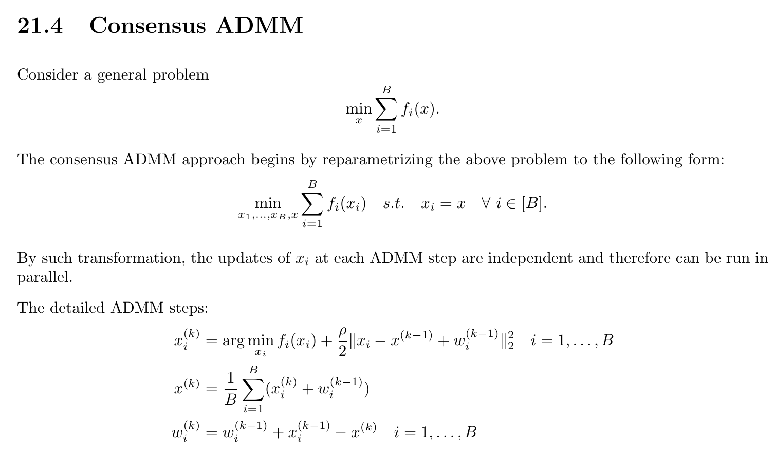
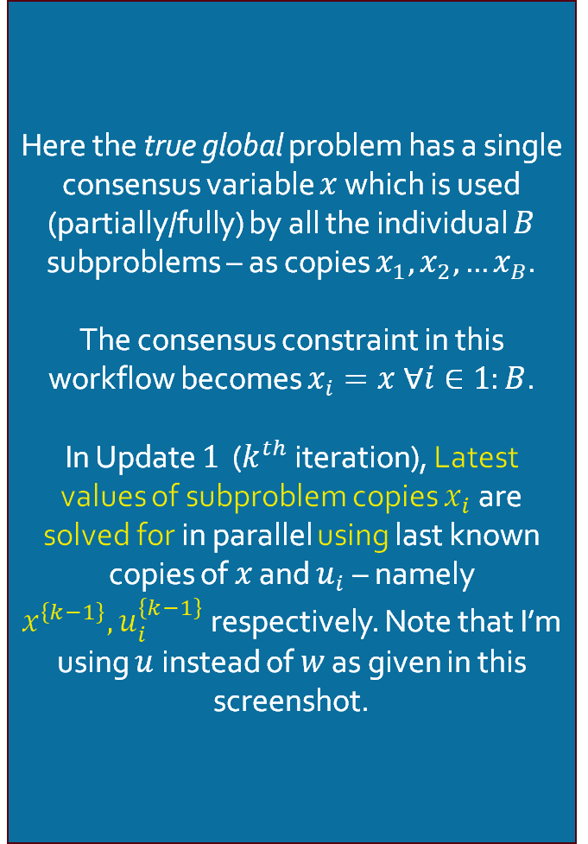

Consensus ADMM formulation
Update $1$: Solve for $x_{i}^{k} ∀i∈1:B$
Here the true global problem has a single consensus variable $x$ which is used (partially/fully) by all the individual $B$ subproblems – as copies $x_{1},x_{2},…x_{B}$.
The consensus constraint in this workflow becomes $x_{i}=x ∀i∈1:B$.
In Update $1$ ($k^{th}$ iteration), Latest values of subproblem copies $x_{i}$ are solved for in parallel using last known copies of $x$ and $u_{i}$ – namely $x^{\left\{k−1\right\}}, u_{i}^{\left\{k−1\right\}}$ respectively. Note that I’m using $u$ instead of $w$ as given in this screenshot.
Note: This is like a one-sided ADMM formluation
Source: [ADMM notes CMU]

Slide 20
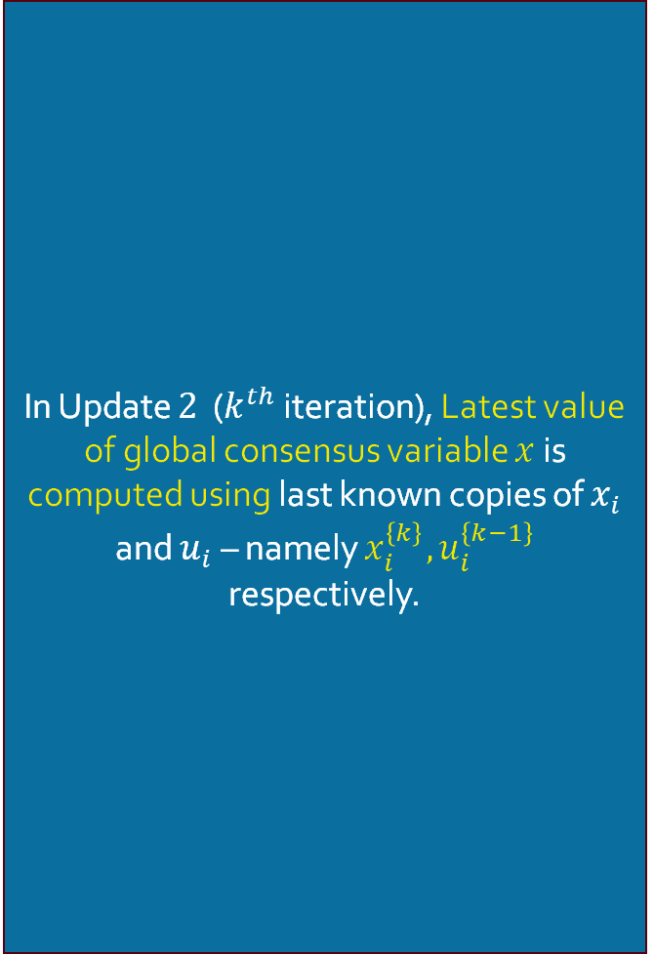

Consensus ADMM formulation
Update $2$: Solve for $x^{k}$
In Update $2$ ($k^{th}$ iteration), Latest value of global consensus variable $x$ is computed using last known copies of $x_{i}$ and $u_{i}$ – namely $x_{i}^{\left\{k\right\}}, u_{i}^{\left\{k−1\right\}}$ respectively.

Slide 21
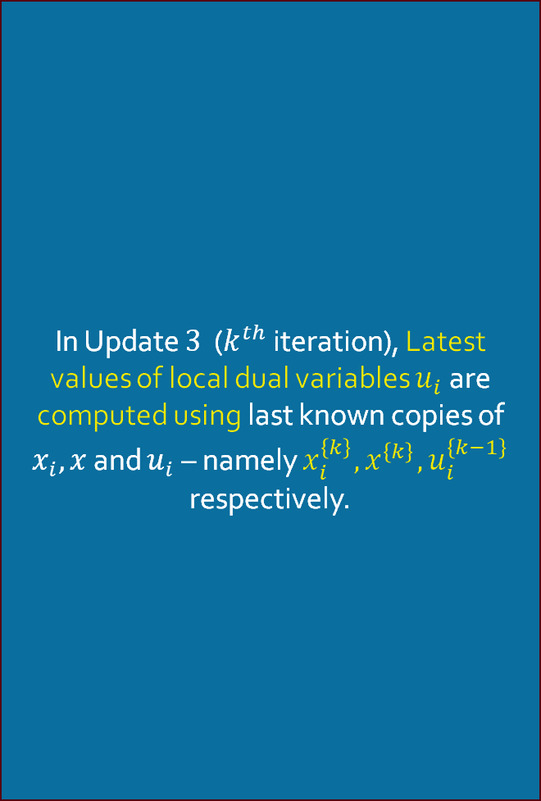

Consensus ADMM formulation
Update $3$: Solve for $u_{i}^{k} ∀ i∈1:B$
In Update $3$ ($k^{th}$ iteration), Latest values of local dual variables $u_{i}$ are computed using last known copies of $x_{i}, x$ and $u_{i}$ – namely $x_{i}^{\left\{k\right\}}, x^{\left\{k\right\}},u_{i}^{\left\{k−1\right\}}$ respectively.

Slide 22
Consensus ADMM formulation
Graph Illustration
Individual Subproblem $i$
Individual Subproblem $i$
Individual Subproblem $i$
Global Problem
Individual Subproblem $i$
Individual Subproblem $i$
Individual Subproblem $i$

Slide 23
Consensus ADMM formulation for MPOPF
Description

Slide 24
Consensus ADMM formulation for MPOPF
Description

Slide 25
Consensus ADMM formulation for MPOPF
Description

Slide 26
References
[ADMM notes CMU] Index of /~ryantibs/convexopt/scribes. (2025, September 01). Retrieved from https://www.stat.cmu.edu/~ryantibs/convexopt/scribes

Slide 27
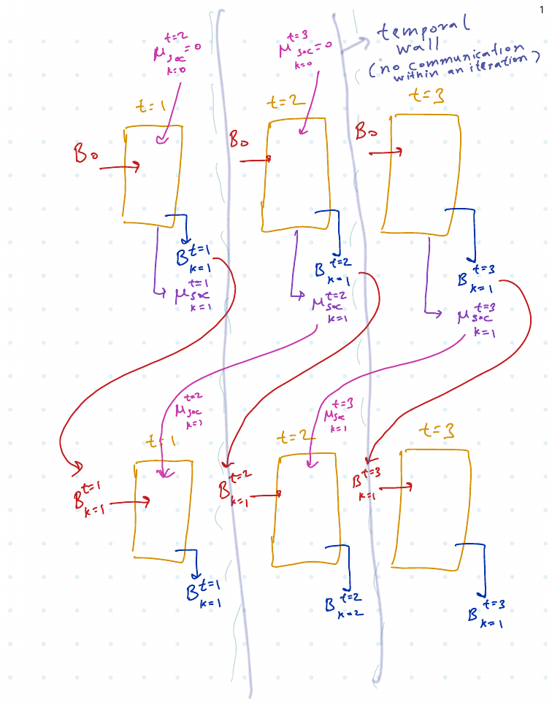

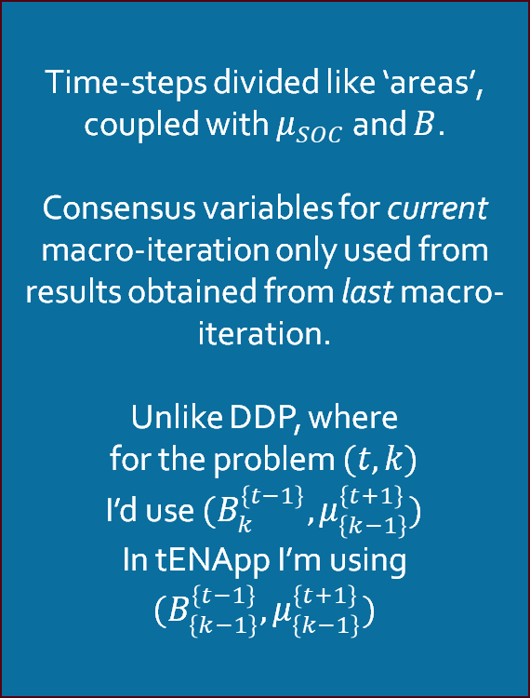
tENApp Algorithm Terminal SOC Constraint Relaxed
$$tENApp$$
Time-steps divided like ‘areas’, coupled with $μ_{SOC}$ and $B$.
Consensus variables for current macro-iteration only used from results obtained from last macro-iteration.
Unlike DDP, where
for the problem $(t, k)$
I’d use $(B_{k}^{\left\{t−1\right\}}, μ_{\left\{k−1\right\}}^{\left\{t+1\right\}})$
In tENApp I’m using $(B_{\left\{k−1\right\}}^{\left\{t−1\right\}}, μ_{\left\{k−1\right\}}^{\left\{t+1\right\}})$

Slide 28
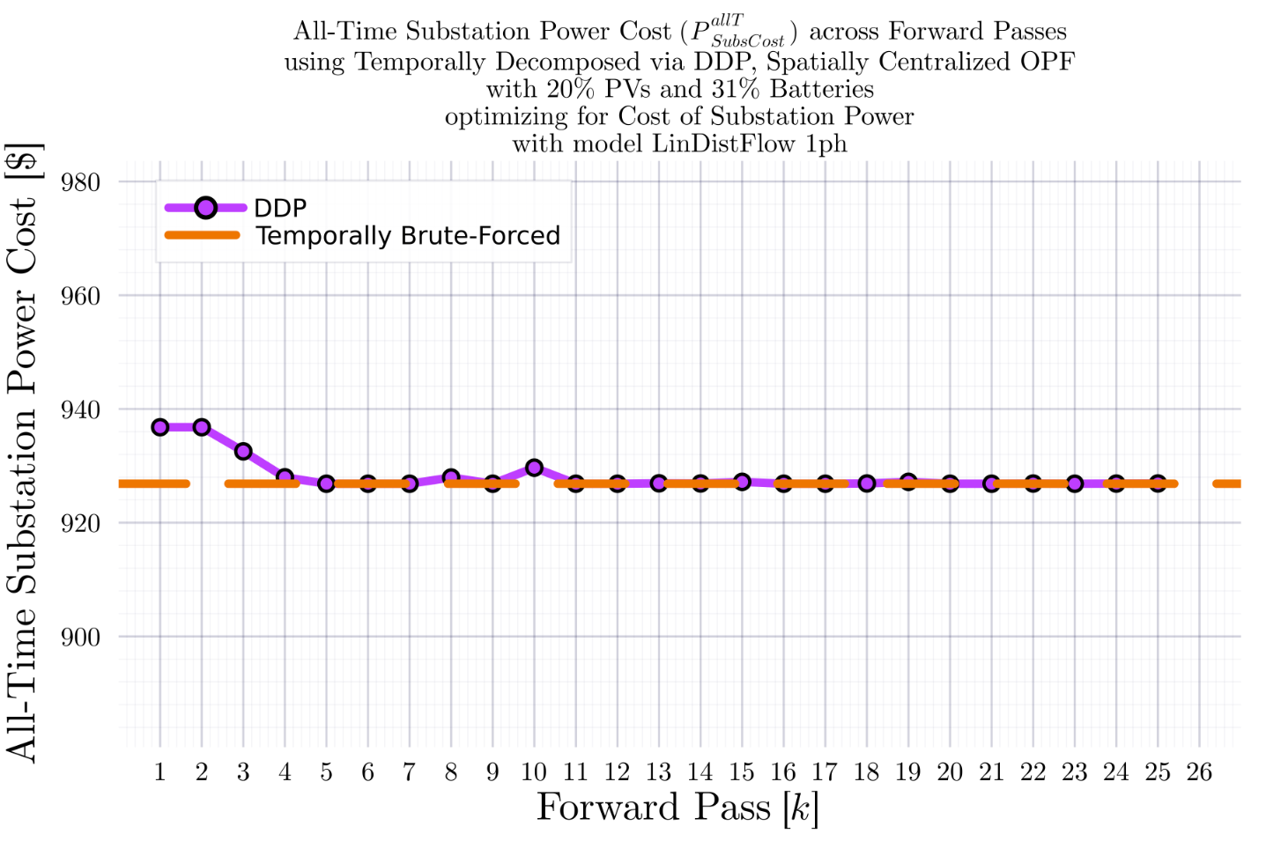
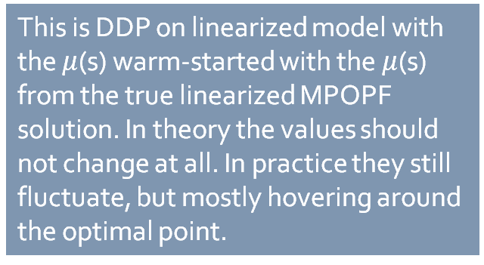
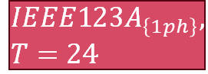
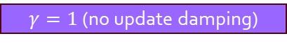


DDP Trajectory vs #Forward Passes $[k]$: LinDistFlow Model Terminal SOC Constraint Relaxed
$$IEEE123A_{\left\{1ph\right\}}, T=24$$
BruteForced (BF)
$$DDP$$
This is DDP on linearized model with the $μ$(s) warm-started with the $μ$(s) from the true linearized MPOPF solution. In theory the values should not change at all. In practice they still fluctuate, but mostly hovering around the optimal point.
$γ=1$ (no update damping)
$$k_{Max}=25$$

Slide 29
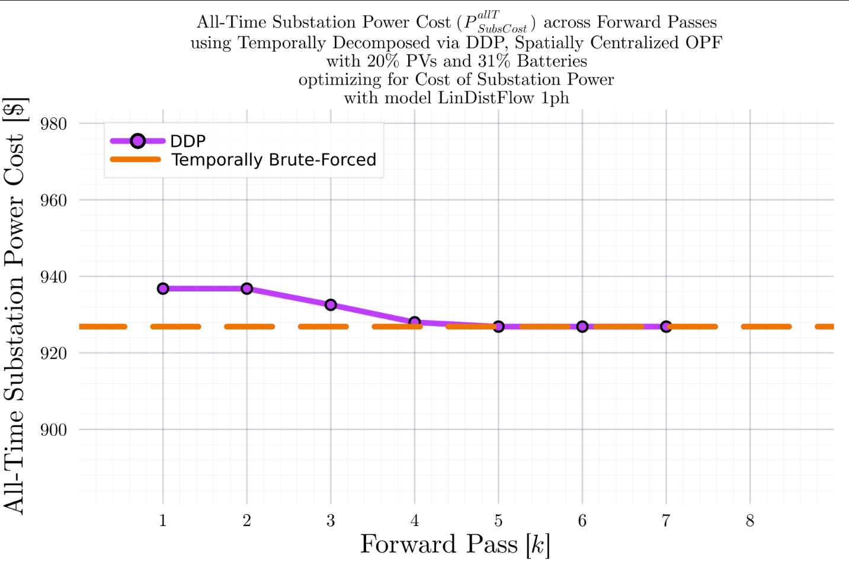
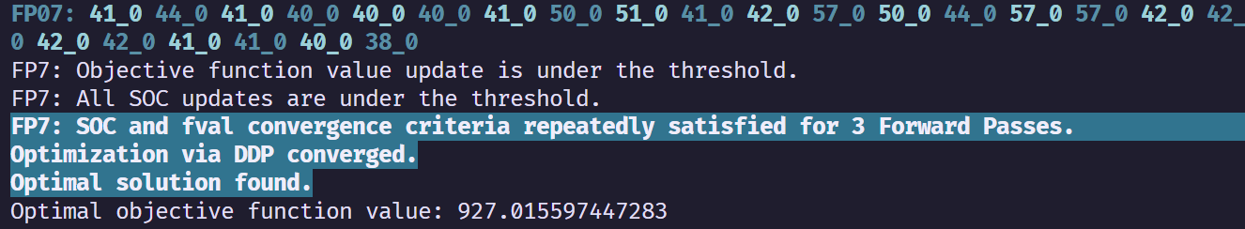
DDP Trajectory vs #Forward Passes $[k]$: LinDistFlow Model Terminal SOC Constraint Relaxed
$$IEEE123A_{\left\{1ph\right\}}, T=24$$
BruteForced (BF)
$$DDP$$
With some ‘convergence-catching’ heuristic in place (declare convergence if SOC and fval are not changing for 3 Forward Passes), DDP converges.
$γ=1$ (no update damping)
$$k_{Max}=25$$

Slide 30
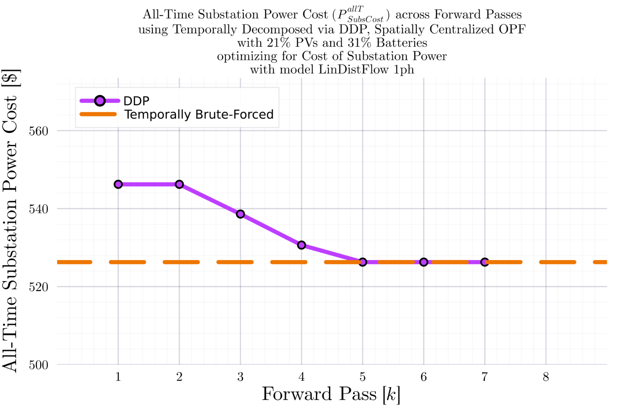
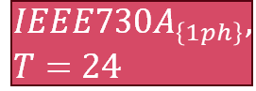
DDP Trajectory vs #Forward Passes $[k]$: LinDistFlow Model Terminal SOC Constraint Relaxed
$$IEEE730A_{\left\{1ph\right\}}, T=24$$
BruteForced (BF)
$$DDP$$
With some ‘convergence-catching’ heuristic in place (declare convergence if SOC and fval are not changing for 3 Forward Passes), DDP converges.
$γ=1$ (no update damping)
$$k_{Max}=25$$

Slide 31






tENApp Trajectory vs #Forward Passes $[k]$: LinDistFlow Model Terminal SOC Constraint Relaxed
$$IEEE3A_{\left\{1ph\right\}}, T=24$$
BruteForced (BF)
$$tENApp$$
$γ=1$ (no update damping)
$$k_{Max}=50$$
$$α=4.00$$

Slide 32


tENApp Trajectory vs #Forward Passes $[k]$: LinDistFlow Model Terminal SOC Constraint Relaxed
$$IEEE123A_{\left\{1ph\right\}}, T=24$$
BruteForced (BF)
$$tENApp$$
$γ=1$ (no update damping)
$$k_{Max}=50$$

Slide 33



tENApp Trajectory vs #Forward Passes $[k]$: LinDistFlow Model Terminal SOC Constraint Relaxed
$$IEEE123A_{\left\{1ph\right\}}, T=06$$
BruteForced (BF)
$$tENApp$$
$γ=1$ (no update damping)
$$k_{Max}=50$$
$$α=1.00$$

Slide 34

tENApp Trajectory vs #Forward Passes $[k]$: LinDistFlow Model Terminal SOC Constraint Relaxed
$$IEEE123A_{\left\{1ph\right\}}, T=06$$
BruteForced (BF)
$$tENApp$$
$γ=1$ (no update damping)
$$k_{Max}=50$$
$$α=0.43$$

Slide 35



tENApp Trajectory vs #Forward Passes $[k]$: LinDistFlow Model Terminal SOC Constraint Relaxed
$$IEEE123A_{\left\{1ph\right\}}, T=12$$
BruteForced (BF)
$$tENApp$$
$γ=1$ (no update damping)
$$k_{Max}=100$$
$$α=0.43$$

Slide 36


tENApp Trajectory vs #Forward Passes $[k]$: LinDistFlow Model Terminal SOC Constraint Relaxed
$$IEEE123A_{\left\{1ph\right\}}, T=24$$
BruteForced (BF)
$$tENApp$$
$γ=1$ (no update damping)
$$k_{Max}=100$$
$$α=3.00$$

Slide 37



tENApp Trajectory vs #Forward Passes $[k]$: LinDistFlow Model Terminal SOC Constraint Relaxed
$$IEEE123B_{\left\{1ph\right\}}, T=24$$
BruteForced (BF)
$$tENApp$$
$γ=1$ (no update damping)
$$k_{Max}=100$$
$$α=3.00$$

Slide 38

tENApp Trajectory vs #Forward Passes $[k]$: LinDistFlow Model Terminal SOC Constraint Relaxed
$$IEEE123A_{\left\{1ph\right\}}, T=12$$
BruteForced (BF)
$$tENApp$$
$γ=1$ (no update damping)
$$k_{Max}=100$$
$$α=0.75$$

Slide 39


DDP Trajectory vs #Forward Passes $[k]$: LinDistFlow Model Terminal SOC Constraint Relaxed
$$IEEE123B_{\left\{1ph\right\}}, T=24$$
BruteForced (BF)
$$DDP$$
DDP didn’t converge in the given number of iterations..
$γ=1$ (no update damping)
$$k_{Max}=50$$

Slide 40


DDP Trajectory vs #Forward Passes $[k]$: LinDistFlow Model Terminal SOC Constraint Relaxed
$$IEEE123B_{\left\{1ph\right\}}, T=24$$
BruteForced (BF)
$$DDP$$
With some ‘convergence-catching’ heuristic in place (declare convergence if SOC and fval are not changing for 3 Forward Passes), DDP converges.
Tolerance:
fval: $\$0.1$
SOC: $0.01pu$
$γ=1$ (no update damping)
$$k_{Max}=50$$

Slide 41









DDP Trajectory vs #Forward Passes $[k]$: LinDistFlow Model Terminal SOC Constraint Relaxed
$$IEEE123A_{\left\{1ph\right\}}, T=24$$
BruteForced (BF)
$$DDP$$
$γ=1$ (no update damping)
$γ=1$ (no update damping)
$$γ=0.5$$
$$γ=0.5$$
$$k_{Max}=25$$

Slide 42









DDP Trajectory vs #Forward Passes $[k]$ Terminal SOC Constraint Relaxed
$$IEEE123A_{\left\{1ph\right\}}, T=3$$
BruteForced (BF)
$$DDP$$
$$FP\left(k\right):μ_{k}\left(t=1\right), μ_{k}\left(t=2\right), μ_{k}(t=3)$$
$$μ_{used}=\frac{μ^{k−1}+α∗μ^{k−2}}{1+α}$$
$$α^{k}=α_{0}∗γ^{k−2}$$
$$α_{0}=1.0$$
$γ=1$ (no update damping)
$$γ=0.5$$
$$k_{Max}=25$$
$γ=1$ (no update damping)
$$γ=0.5$$
Fluctuation ${\text{of} μ}_{k}^{T}$ value between $0$ and a ‘regular’ non-zero value

Slide 43








DDP Trajectory vs #Forward Passes $[k]$ Terminal SOC Constraint Relaxed
$$IEEE123A_{\left\{1ph\right\}}, T=6$$
BruteForced (BF)
$$DDP$$
$γ=1$ (no update damping)
$$γ=0.5$$
$γ=1$ (no update damping)
$$γ=0.5$$
$$k_{Max}=25$$

Slide 44





DDP Trajectory vs #Forward Passes $[k]$ Terminal SOC Constraint Relaxed
$$IEEE123A_{\left\{1ph\right\}}, T=24$$
BruteForced (BF)
$$DDP$$
$γ=1$ (no update damping)
$γ=1$ (no update damping)
$$γ=0.5$$
$$γ=0.5$$
$$k_{Max}=25$$

Slide 45



DDP Trajectory vs #Forward Passes $[k]$ Terminal SOC Constraint Relaxed
$$IEEE123A_{\left\{1ph\right\}}, T=96$$
BruteForced (BF)
$$DDP$$
$$k_{Max}=25$$

Slide 46










DDP Trajectory vs #Forward Passes $[k]$ Terminal SOC Constraint Relaxed
$$IEEE123B_{\left\{1ph\right\}}, T=96$$
BruteForced (BF)
$$DDP$$
$γ=1$ (no update damping)
$γ=1$ (no update damping)
$$k_{Max}=25$$

Slide 47








DDP Trajectory vs #Forward Passes $[k]$ Terminal SOC Constraint Relaxed
$$IEEE123B_{\left\{1ph\right\}}, T=24$$
BruteForced (BF)
$$DDP$$
$γ=1$ (no update damping)
$γ=1$ (no update damping)
$$γ=0.5$$
$$γ=0.5$$
$$k_{Max}=25$$

Slide 48




DDP Trajectory vs #Forward Passes $[k]$ Terminal SOC Constraint Relaxed
$$IEEE123B_{\left\{1ph\right\}}, T=24$$
BruteForced (BF)
$$DDP$$
$$k_{Max}=11$$

Slide 49




DDP Trajectory vs #Forward Passes $[k]$ Terminal SOC Constraint Relaxed
$$IEEE123B_{\left\{1ph\right\}}, T=24$$
$$DDP$$
$$k_{Max}=11$$

Slide 50




DDP Trajectory vs #Forward Passes $[k]$ Terminal SOC Constraint Relaxed
$$IEEE123B_{\left\{1ph\right\}}, T=24$$
BruteForced (BF)

Slide 51



DDP Trajectory vs #Forward Passes $[k]$ Terminal SOC Constraint Relaxed
$$IEEE123B_{\left\{1ph\right\}}, T=24$$
BruteForced (BF)
$$DDP$$
$$k_{Max}=7$$

Slide 52



DDP Trajectory vs #Forward Passes $[k]$ Terminal SOC Constraint Relaxed
$$IEEE123B_{\left\{1ph\right\}}, T=24$$
$$DDP$$
$$k_{Max}=11$$

Slide 53


DDP Trajectory vs #Forward Passes $[k]$ Terminal SOC Constraint Relaxed
$$IEEE123B_{\left\{1ph\right\}}, T=24$$
BruteForced (BF)
$$DDP$$
$$k_{Max}=25$$

Slide 54



DDP Trajectory vs #Forward Passes $[k]$ Terminal SOC Constraint Relaxed
$$IEEE123B_{\left\{1ph\right\}}, T=24$$
$$DDP$$
$$k_{Max}=25$$

Slide 55


IEEE 730 1ph Node System
34 12.66kV to 12.66kV branches (high impedance)
43 12.66kV to 0.24kV branches (low impedance)
$$k{V_{B}}_{Sys}=0.24$$
$$kV_{B_{Sec}}=0.24$$
$$kV_{B_{Pri}}=12.66$$
$$MV{A_{B}}_{Sys}=100$$
$$MVA_{B_{Xfm}}=0.07$$
$$Z_{B_{Sys}}=Z_{B_{Sec}}=0.000576$$
$$Z_{B_{Pri}}=1.602756$$
1
2
2
2
1
4
1
1
1
0
1
4
1
1
1
1
2
1
2
1
1
1
1
1
1
1
1
1
1
1
1
1
0
1
0
1

Slide 56


Comparison of BFM-NL-1ph and LinDistFlow-1ph Optimization Results
LinDistFlow Optimal Actions used in OpenDSS
BFM-NL
Optimal Actions used in OpenDSS

Slide 57


Comparison of BFM-NL-1ph and LinDistFlow-1ph Optimization Results
LinDistFlow Own Solutions
BFM-NL Own Solutions

Slide 58


Comparison of BFM-NL-1ph and LinDistFlow-1ph Optimization Results
LinDistFlow
BFM-NL

Slide 59








DDP Trajectory vs #Forward Passes $[k]$ Terminal SOC Constraint Relaxed
$$ADS{10}_{1ph}, T=96$$
BruteForced (BF)
$$DDP$$
Looks ‘successful’
$$k_{Max}=33$$

Slide 60







DDP Trajectory vs #Forward Passes $[k]$ Terminal SOC Constraint Relaxed
$$IEEE{123}_{1ph}, T=96$$
BruteForced (BF)
$$DDP$$
Looks ‘successful’
$$k_{Max}=33$$

Slide 61







DDP Trajectory vs #Forward Passes $[k]$ Terminal SOC Constraint Relaxed
$$ADS{10}_{1ph}, T=24$$
BruteForced (BF)
$$DDP$$
Looks ‘successful’
$$k_{Max}=33$$

Slide 62






DDP Trajectory vs #Forward Passes $[k]$ Terminal SOC Constraint Relaxed
$$IEEE{123}_{1ph}, T=24$$
BruteForced (BF)
$$DDP$$
Looks ‘successful’
$$k_{Max}=33$$

Slide 63







DDP Trajectory vs #Forward Passes $[k]$ Terminal SOC Constraint Relaxed
$$ADS{10}_{1ph}, T=12$$
BruteForced (BF)
$$DDP$$
Will NOT converge
$$k_{Max}=33$$
Even if not converging, it at least does ‘hit’ the optimal value periodically.

Slide 64



DDP Trajectory vs #Forward Passes $[k]$ Terminal SOC Constraint Relaxed
$$ADS{10}_{1ph}, T=12$$
BruteForced (BF)
$$DDP$$
Will NOT converge
$$k_{Max}=55$$
Even if not converging, it at least does ‘hit’ the optimal value periodically.

Slide 65




DDP Trajectory vs #Forward Passes $[k]$ Terminal SOC Constraint Relaxed
$$ADS{10}_{1ph}, T=12$$
BruteForced (BF)
$$DDP$$
Will NOT converge
$$k_{Max}=77$$
Even if not converging, it at least does ‘hit’ the optimal value periodically.

Slide 66




DDP Trajectory vs #Forward Passes $[k]$ Terminal SOC Constraint Relaxed
$$ADS{10}_{1ph}, T=12$$
BruteForced (BF)
$$DDP$$
Will NOT converge
$$k_{Max}=222$$
Even if not converging, it at least does ‘hit’ the optimal value periodically.

Slide 67







DDP Trajectory vs #Forward Passes $[k]$ Terminal SOC Constraint Relaxed
$$IEEE{123}_{1ph}, T=12$$
BruteForced (BF)
$$DDP$$
Will NOT converge
$$k_{Max}=33$$
Even if not converging, it at least does ‘hit’ the optimal value periodically.

